Slide 1

L. J. University
L.J. School of
Computer Applications
Department of
Master of Computer Application
Fashion Hub
Group Number: MCA_4_42
Internal Guide By: Prof. Krunal Panchal

Slide 2
Group Members:
Group no | Div/Roll No | Enrollment No | Student Name
42 | B_08 | 23002401110022 | Kushwaha Vijay Rajendra
42 | B_24 | 23002401110055 | Varma Shivam Nareshkumar

Slide 3
Index
Sr. No | Details
1 | Introduction
 | 1.1. Existing System
 | 1.2. Need of the new system
 | 1.3. Objective of the System
 | 1.4. Problem Definition
 | 1.5. Core Component
 | 1.6. Project Profile
 | 1.7. Assumptions and Constraints
 | 1.8. Advantages and Limitations of the Proposed System
2 | Requirement Determination and Analysis
 | 2.1. Requirement Determination
 | 2.2. Requirement Specification
 | 2.3. Targeted User
3 | System Design
 | 3.1. Use Case Diagram
 | 3.2. Data Dictionary
4 | Development
 | 4.1. Coding Standards
 | 4.2. Screen Shots

Slide 4
5 | Agile Document
 | 5.1. Agile Project Character
 | 5.2. Agile Roadmap / Schedule
 | 5.3. Agile Project Plan
 | 5.4. Agile User Story (Minimum 3 Tasks)
 | 5.5. Agile Release Plan
 | 5.6. Agile Sprint Backlog
 | 5.7. Agile Test Plan
 | 5.8. Earned-value and burn charts
6 | Proposed Enhancement
 | 6.1. Proposed Enhancement
7 | Conclusion
 | 7.1. Conclusion
8 | Bibliography
 | 8.1. Bibliography

Slide 5
Introduction

Slide 6
1.1
EXSISTING SYSTEM

Slide 7
Website | Pros | Cons | Features | Modules
Vero Moda | User-Friendly Design Responsive and Mobile-Friendly, Efficient Search and Filters | No Live Chat Support, Limited Product Information, Size Inconsistencies, Cluttered Navigation, on All Items, Difficulty in Contacting Customer Support: | Product Search, Categories and Filters, High-Quality Product Pages, Customer Accounts, Order Tracking, Returns and Exchanges, Size Guide | Community Awareness Section, Blog or Style Inspiration, Subscription & Exclusive Memberships, Personalized Recommendations
KALKI Fashion | Well-Organized Categories, High-Quality Images, Comprehensive Product Descriptions, Store Locator | Slow Loading Times, Limited International Shipping, No Live Chat Support, Return Process Delays | Product Search, Filters and Sorting Options, Add to Cart and Shopping Cart Management, Secure Checkout, Order Tracking, Returns and Exchanges | Loyalty & Rewards Program, Interactive Lookbook / Style Guide, Social Proof & Influencer Integration, Subscription & Exclusive Memberships
Snitch | Trendy Designs, Variety, User-Friendly interface, Trendy & Fast Fashion Updates | Return Policy Fees, Product Quality concerns, App performance Over Website, Stock Availability | Product Browsing & Categories, Product Details Page, User Account Management, Customer Support, Newsletter Sign-Up, Mobile App Integration | Order Tracking and Notifications, BackinStockNotifications, User Empowerment Features, Community Awareness Section

Slide 8
1.2
NEED FOR THE NEW SYSTEM

Slide 9
1. Better Product Display
High-quality images and clear descriptions help customers choose better.
Well-organized categories make browsing easier.
2. Improved Customer Experience
Wishlist, personalized recommendations, and loyalty programs keep customers engaged.
A smooth and easy-to-use website makes shopping hassle-free.
3. Clear Product Information
Accurate size guides, fabric details, and reviews help customers make the right choice.
This reduces returns and increases customer satisfaction.
4. Safe and Secure Payments
Customers need a secure payment system to trust the website.
Multiple payment options like credit/debit cards, and cash should be available.
5. Fast and Reliable Delivery
Customers expect quick deliveries with proper tracking.
Providing estimated delivery times and express shipping options builds trust.
6. Easy Order Tracking
Customers should be able to track their orders.
Notifications for order confirmation, shipping, and delivery updates improve the experience.

Slide 10
1.3
OBJECTIVE OF THE NEW SYSTEM

Slide 11
Enhanced User Experience (UX) – Ensure easy navigation with clear categories, filters (size, price, etc.), and fast-loading pages.
Improved Product Presentation – Use high-quality images and videos with zoom features to give customers a detailed view of products.
Customer Engagement and Support – Allow customer reviews and ratings to build trust and create a strong shopping community.
Customer Feedback and Continuous Improvement – Collect regular feedback through surveys and reviews to improve the website based on user needs.
Seasonal & Regional Trends – Stock clothing based on local fashion trends, weather, and cultural preferences to attract more customers.
Fast Delivery for Local Customers – Offer quick shipping options for local buyers, ensuring they receive their orders Provide same-day or next-day delivery a better shopping experience.

Slide 12
1.4
PROBLEM DEFINITION

Slide 13
With the increasing demand for online shopping, customers are looking for convenient, fast, and reliable platforms to purchase clothing. However, many local fashion retailers lack an efficient online presence, which limits their reach and makes it difficult to manage orders, showcase products, and provide a smooth customer experience. The Fashion Hub website aims to solve this problem by offering a centralized digital platform where businesses can display their clothing collections, manage inventory, handle customer orders, and provide a user-friendly shopping experience. The goal is to bridge the gap between local fashion stores and modern consumer expectations through a reliable and scalable e-commerce solution.

Slide 14
1.5
CORE COMPONENT

Slide 15
Product Management System:
A backend interface that allows administrators to add, update, categorize, and manage clothing items, including details like descriptions, prices, sizes, colors, and stock levels.​
2. User Account Management:
Enables customers to create and manage personal accounts, track orders,save favorite items, and manage shipping addresses.​
3. Shopping Cart and Checkout System:
Facilitates the selection of multiple items, adjusts quantities, applies
discount
codes, calculates totals, and processes payments securely.​
4. Payment Gateway Integration:
Connects the website to payment processors to handle transactions via credit/debit cards, digital wallets, or other payment methods securely.
5. Banner Management:
Utilizing banners for promotions, new arrivals, or special events captures customer attention and drives engagement. Effective banner management allows for timely updates and targeted marketing campaigns.

Slide 16
6. Brand Collaboration :
Dedicated pages for brand collaborations showcase exclusive collections and partnerships, enhancing brand value and attracting customers interested in specific brands or designer collaborations.​
7. Customer Reviews Management:
Incorporating a review system builds trust and provides social proof, as potential buyers can read about others' experiences with products, influencing their purchasing decisions. 6. Admin Dashboard & Analytics

Slide 17
1.6
PROJECT PROFILE

Slide 18
Project Name: Fashion Hub
Technologies Used : HTML,CSS, JavaScript, Laravel (PHP)
Database: MY SQL

Slide 19
1.7
ASSUMPTIONS AND CONSTRAINT

Slide 20
Assumptions
Growing Trend: Rising demand for online clothing shopping in India.
Mobile & Internet: Customers mainly shop via mobile with stable internet.
Diverse Preferences: Wide variety of categories needed (Men,Women, Kids).
Payment Options: Multiple payment methods required ( cards, COD).
Delivery Expectations: Fast, reliable delivery with tracking (same/next-day in metros).
Trust & Security: Secure payments and data protection are essential.
Competitive Pricing: Price comparisons require attractive deals and discounts.
Festive Demand: Higher traffic during festivals; scalable infrastructure needed.

Slide 21
Constraints
Logistics & Delivery Limitations: Fast delivery is easy in metros but slower in rural areas due to logistical challenges.
High Competition: Must compete with major e-commerce giants like Amazon, Flipkart, and Myntra.
Payment Failures & Fraud: Risk of failed payments, chargebacks, or fraudulent orders.
Return & Refund Management: Efficient handling of returns while minimizing losses.
Inventory Management: Real-time stock tracking to prevent overselling.
Customer Trust Issues: Some users may be hesitant due to past negative online shopping experiences.
Technical Scalability: Need to handle traffic spikes during sales or festive seasons.
Regional Language Support: Localization required to cater to diverse languages across India.
Internet Speed Variability: Optimize for customers with slow internet in remote areas.
Regulatory Compliance: Adherence to e-commerce laws, data protection rules, and GST regulations

Slide 22
1.8
ADVANTAGES AND LIMITATIONS

Slide 23
Advantages
Targeted Local Audience: Focus on local trends to build strong relationships and community loyalty.
Diverse Product Range: Offer a wide variety of clothing styles, sizes, and options for all customer needs.
Convenient Payment & Checkout: Multiple payment methods (PayPal, COD, cards) ensure customer convenience and security.
Reduced Shipping Costs: Local delivery options reduce shipping costs and enable faster delivery (same/next-day).
Building Local Brand Identity: Establish strong community presence for word-of-mouth referrals and local partnerships

Slide 24
Limitations:
Limited Market Reach: Geographical constraints limit growth compared to global platforms; seasonal demand affects sales.
Competition with Local Stores: Faces competition from physical stores, and price sensitivity may drive customers to shop in-store.
Initial Development & Maintenance Costs: High initial investment for website development and ongoing maintenance costs.
Technical Challenges: Downtime and payment gateway errors can lead to lost sales and customer dissatisfaction.

Slide 25
2
REQUIREMENT DETERMINATION AND ANALYSIS

Slide 26
2.1
REQUIREMENT DETERMINATION

Slide 27
Functional Requirements:
a. User Authentication & Account Management
Secure sign-up and login using email, mobile OTP, or social media.
Profile management for users to save addresses, view order history, and manage preferences.
b. Product Catalog & Search Functionality
Products categorized under Men, Women, Kids, Ethnic Wear, Western Wear, Accessories, etc.
Advanced filters based on price, brand, size, fabric, color, and discounts.
AI-powered recommendations based on browsing history and past purchases.
c. Shopping Cart & Checkout Process
Users can add, remove, or update items in the cart.
Secure checkout with multiple payment options Cards, COD).
d. Order Management
Admins can view and manage customer orders, including order status and shipping details.
Customers should receive notifications about their order status

Slide 28
Non-Functional Requirements:
a. Performance & Scalability
The website should handle high traffic, especially during festive sales.
Page loading speed should be optimized for low internet connectivity areas.
b. Security & Data Protection
End-to-end encryption for secure transactions and data privacy.
Compliance with Indian e-commerce regulations (IT Act, GST, Data Protection Laws).
c. Usability & Accessibility
The platform should be mobile-friendly and responsive.
Support for regional languages to cater to diverse customers.
d. Backup & Recovery
Regular data backups to prevent loss of order and user information.
Disaster recovery plan for handling unexpected downtimes.

Slide 29
2.2
REQUIREMENT SPECIFATION

Slide 30
2.2.1. User Roles and Permissions
The website will have two main user roles:
a. Admin Role
Full control over product management, orders, and customer data.
Manage categories, inventory, and stock availability.
Handle customer queries and returns.
Generate reports on sales, user engagement, and trends.
b. Customer Role
Browse and search for clothing items based on categories, filters, and preferences.
Add products to the cart, wishlist, or directly purchase.
Make secure payments and track order status.
Provide product reviews and ratings.

Slide 31
2.2.2 User Authentication and Security
Secure login and registration using email, Password or social media login.
Strong password encryption and secure user data storage.
Role-based access: Admins have full access, customers have limited access.
2.2.3 Product Management
Categories: Men, Women, Kids, Accessories, Ethnic Wear, Western Wear.
Filters: Price, Brand, Size, Fabric, Color, Occasion.
Product Details: High-quality images, zoom-in feature, detailed descriptions, size guide, stock availability.
Wishlist Feature: Save favorite items for later purchase.
2.2.4 Shopping Cart and Checkout Process
Add/remove/update items in the cart.
Apply discount codes and promotional offers.
Secure checkout with multiple payment options: Cards, COD.
Auto-save addresses for faster checkout
.

Slide 32
2.2.5. Customer Support and Feedback
Customer reviews and ratings on each product for transparency.
Feedback system for continuous website improvement.
2.2.6. Performance and Scalability
Websites should handle high traffic (festive seasons, sales).
Optimized loading speed for smooth browsing.
Support for mobile and desktop versions.
Scalable architecture to accommodate future growth.
2.2.7. Security and Compliance
SSL encryption for secure transactions.
Compliance with Indian e-commerce laws (GST, IT Act, Data Protection Laws).
Fraud prevention mechanisms for payment security.
Regular data backups and disaster recovery plans.

Slide 33
2.2.8. Technology Stack
The website will be built using HTML, CSS, and JavaScript for the frontend, and Laravel (PHP framework) for the backend.
The server hosting the website should support PHP and MySQL and have enough resources for smooth performance.

Slide 34
2.3
TARGETED USERS

Slide 35
Targeted User
Shoppers
Everyday Buyers: Need casual wear like t-shirts, jeans, and dresses.
Event Shoppers: Look for outfits for weddings, parties, or holidays.
Local Residents
Community Shoppers: Support local businesses and cultural fashion.
Eco-Conscious Buyers: Prefer sustainable, ethical clothing.
Visitors
Tourists: Buy local fashion as souvenirs.
Business Travelers: Need formal wear for meetings or events

Slide 36
3
SYSTEM DESIGN

Slide 37
3.1
USE-CASE DIAGRAM

Slide 38
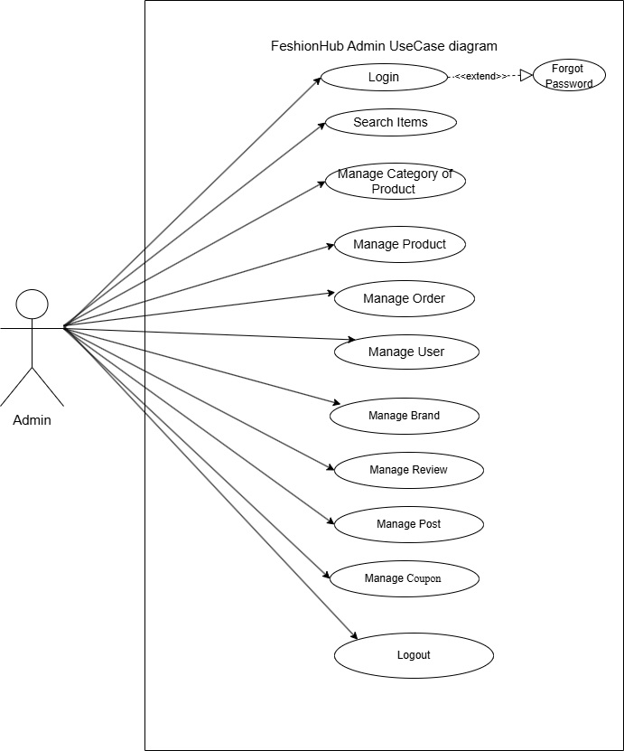
12) Use case Diagram
Admin

Slide 39
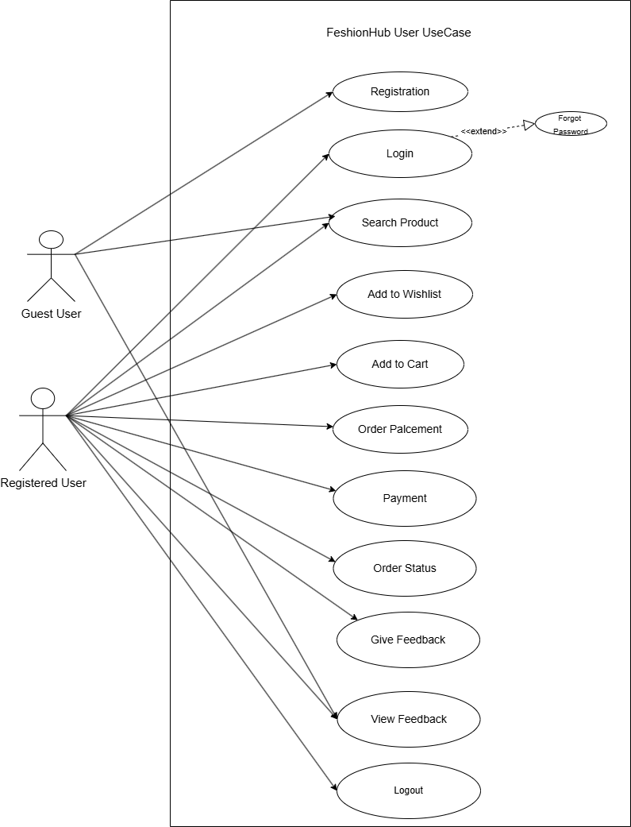
User

Slide 40
3.2
DATA DICTIONARY

Slide 41
1. Registration Table
Field Name | Data Type | Field Length | Constraint | Description | Sample data
User_id | Int | 4 | Primary Key | Auto Increment id | 01
Role | Varchar | 1 | Hidden | Role of user | Admin
Name | Varchar | 20 | Not null | Login name | Shivam
Mobile_no | int | 11 | Not null | contact number | 9558228161
Email | Varchar | 30 | Not null | Email Id To validate user | Shivam004@gmail.com
Password | Varchar | 8 | Not null | password | 12345678
Confirm Password | Varchar | 8 | Not null | password | 12345678

Slide 42
2. Product Category Table
Field Name | Data Type | Field Length | Constraint | Description | Sample data
Category_id | Int | 4 | Primary Key | Auto Increment id | 01
Category_ name | Varchar | 20 | Not null | Name of Category | Men
Image | Varchar | 30 | Not null | Validate Item To User | /storage/photos/ 1/Products/405 b7- pmtk004t.jpg

Slide 43
3. Product Table
Field Name | Data Type | Field Length | Constraint | Description | Sample data
Product_id | Int | 4 | Primary Key | Auto Increment id | 01
Category_id | Int | 4 | Foreign key | Referencing Category table | 05
Product_name | Varchar | 10 | Not null | Product Name | denim jacket
Image | Varchar | 30 | Not null | Image of item | /storage/photos/ 1/Products/405 b7- pmtk004t.jpg
Stock | Int | 4 | Notnull | Product Stock | 2000
Size | Varchar | 4 | Not null | Size of jacket | x,m,l.
Price | Int | 4 | Not null | Price of the product | 100
Description | Varchar | 50 | Not null | Description of item | Premium denim

Slide 44
4. Wishlist Table
Field Name | Data Type | Field Length | Constraint | Description | Sample data
Wishlist_id | Int | 4 | Primary Key | Auto Increment id | 01
User_id | Int | 4 | Foreign key | Referencing User table | 01
Product_id | Int | 4 | Foreign Key | Referencing Product table | 01

Slide 45
5. Cart Table
Field Name | Data Type | Field Length | Constraint | Description | Sample data
Cart_id | Int | 4 | Primary Key | Auto Increment id | 01
User_id | Int | 4 | Foreign key | Referencing User table | 01
Product_id | Int | 4 | Foreign Key | Referencing Product table | 01
Quantity | Int | 2 | Not null | Quantity | 2
TotalPrice | Int | 5 | Not null | Price | 100

Slide 46
6. Order Table
Field Name | Data Type | Field Length | Constraint | Description | Sample data
Order_id | Int | 4 | Primary Key | Auto Increment id | 21
User_id | Int | 4 | Foreign key | Referencing User table | 01
Cart_id | Int | 4 | Foreign Key | Referencing Cart table | 01
Address | Varchar | 70 | Not null | Delivery address | 756, k.k.nagar pvt.lmt
Order_date | date | N/A | Not null | Order date | 2024-04-10
Payment_Mode | Varchar | 4 | COD/Cards | Method of payment | Cash On delivery
Payment_Status | Bool | 2 | Not null | Status | Payment success
Status | Bool | 2 | Not null | Status | Delivered

Slide 47
7. Feedback Table
Field Name | Data Type | Field Length | Constraint | Description | Sample data
F_id | Int | 4 | Primary Key | Auto Increment id | 21
User_id | Int | 4 | Foreign key | Referencing User table | 01
Product_id | Int | 4 | Foreign Key | Referencing Product table | 01
Rating | Varchar | 70 | Not null | Rating in 0 to 5 | 5
Feedback | Varchar | 150 | Not null | Give feedback about product | Best product

Slide 48
4.1
CODING STANDARDS

Slide 49
A well-defined coding standard ensures consistency, readability, and maintainability of the codebase. Below are the best practices and conventions to be followed while developing Fashion Hub.
1 General Best Practices
Follow Consistent Naming Conventions
Use camelCase for variables/functions (getUser Data()).
Use PascalCase for components/classes (UserDashboard).
Use snake_case for database table/column names (user_orders ).
Use UPPER_CASE for constants (JWT_SECRET).
Use Meaningful Names
Bad: let a = getData();
Good: let userDetails = getUserData();
Organize Code into Modules
Separate logic into reusable modules (e.g., Authenticate.php, user.php).
Keep routes, controllers, and models in separate folders

Slide 50
2. BackEnd
2.1 Folder Structure
backend
│── /config # Database & app configuration
│── /controllers # Business logic (e.g., UsersController.php)
│── /middleware # Middleware (e.gAuthenticate.php)
│── /models # Database models (e.g., User.php)
│── /routes # API routes (e.g., api.php)
│── /utils # Helper functions (e.g., sendEmail.php)
│── index.js # Main server file

Slide 51
2.2 Component Naming
Use plural names for collections (e.g., users, orders, payments).
Use lowercase and snake_case or camelCase (e.g., order_items or orderItems).
Avoid special characters or spaces.
2.3 API Best Practices
GET /api/users → Fetch all users
GET /api/users/:id → Fetch user by ID
POST /api/users → Create a user
PUT /api/users/:id → Update user
DELETE /api/users/:id → Delete user
Use HTTP Status Codes Properly
200 OK → Successful request
201 Created → New resource created
400 Bad Request → Invalid input
401 Unauthorized → Authentication required
403 Forbidden → No permission
404 Not Found → Resource not found
500 Internal Server Error → Server issue

Slide 52
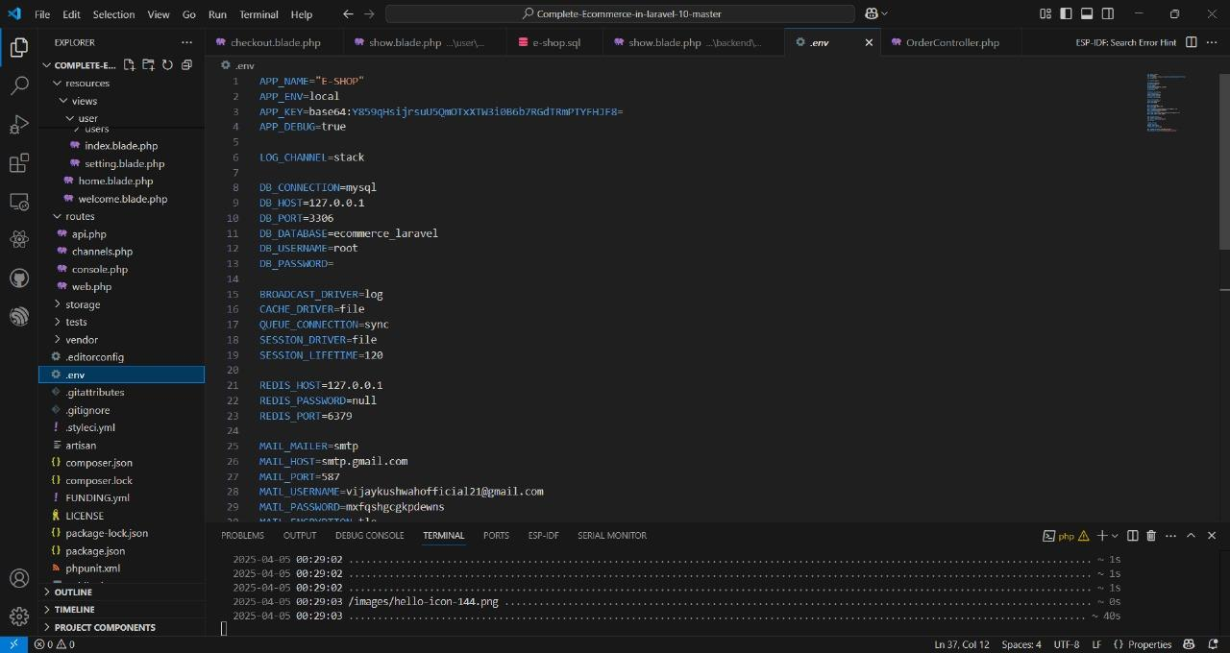
2.4.3 API Best Practices

Slide 53
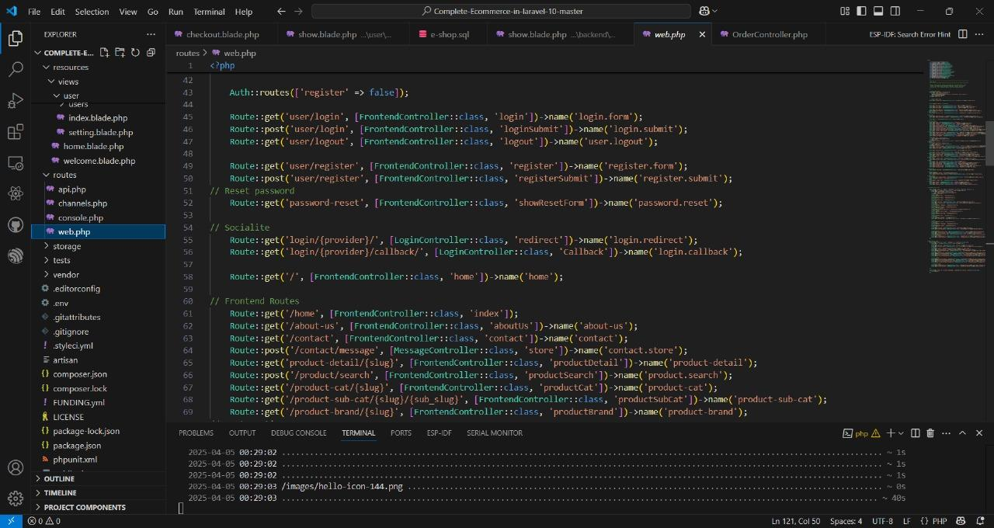
Navigation of pages:

Slide 54
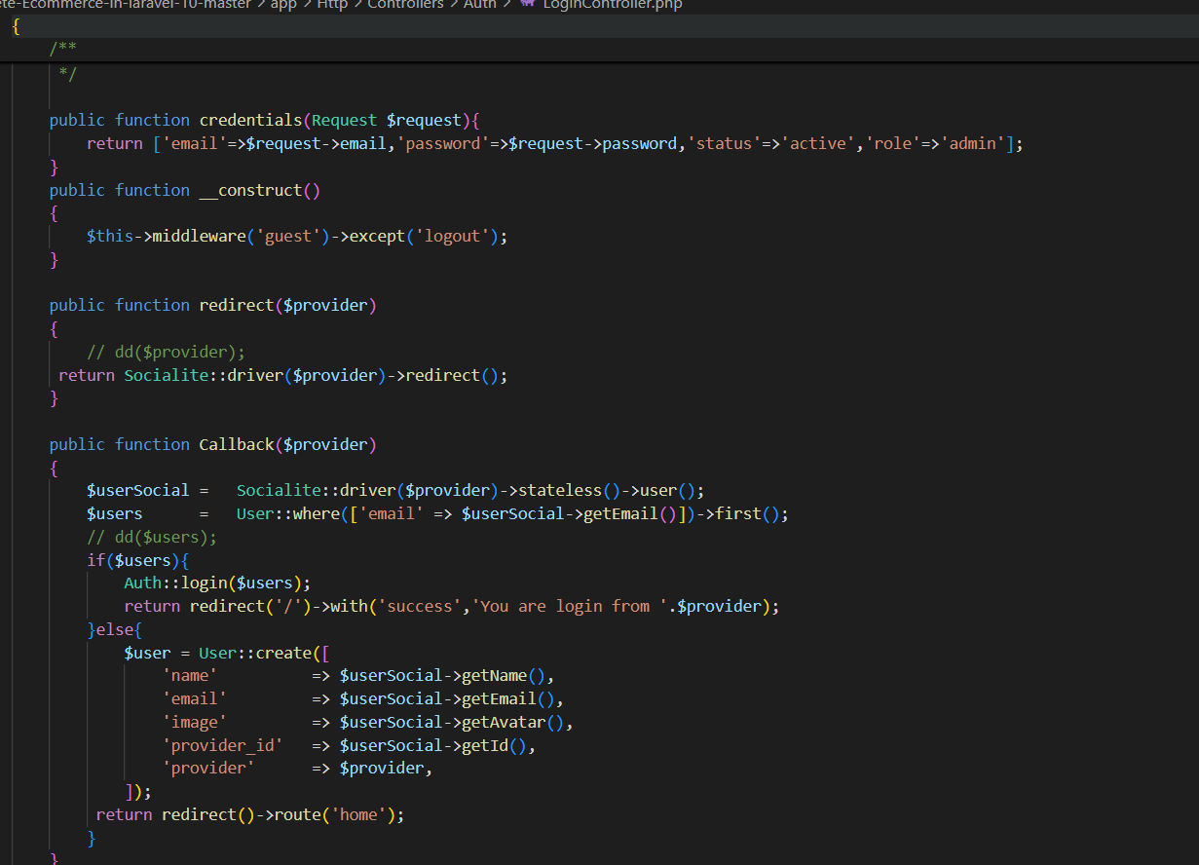
2.4.3 Validation

Slide 55
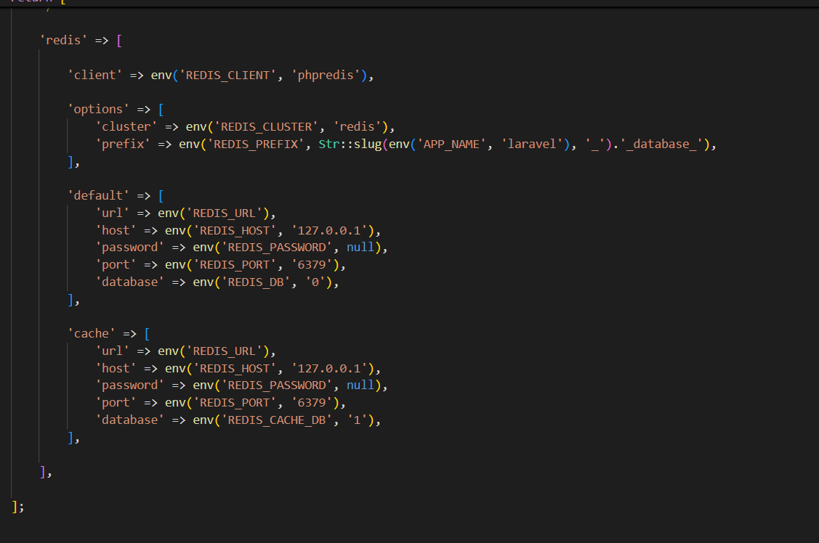
2.4.4 Database Design Standards

Slide 56
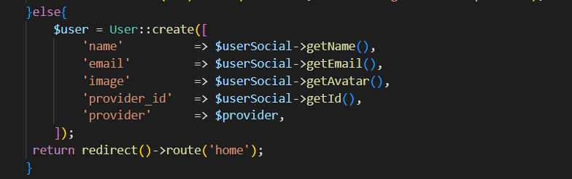
2.4.5 Collection Naming Conventions)

Slide 57
3 Collection Naming Conventions
Use plural names for collections (e.g., users, orders, payments).
Use lowercase and Get_case or camelCase (e.g., get_order_items or getorders).
Avoid special characters or spaces.

Slide 58
4. Database
4.1 Collection Naming
Use plural names for collections (e.g., users, orders, payments).
Use lowercase and snake_case or camelCase (e.g., get order_items or orderItems).
Avoid special characters or spaces.
db.users.find({}, { name: getname, email: getemail }); // Projection
db.orders.find().sort({ createdAt: -1 }).limit(10); // Pagination
db.users.createIndex({ email: getmail }, { unique: true });
db.orders.createIndex({ userId: 1, createdAt: -1 });
4.2 Document Schema Design
Design documents to be embedded when possible (for one-to-few relationships).
Use referencing for one-to-many or many-to-many relationships.
Avoid deeply nested objects (max 3-4 levels deep).

Slide 59
5 Data Integrity & Validation
Use Laravel's built-in validation features to ensure data integrity.
Define validation rules in the controller methods or use Form Request classes.
6. Security Standards
Do not store passwords in plain text. Use Laravel's built-in hashing functions.
Use environment variables for credentials (e.g., .env file).
Enable role-based access control (RBAC) for user permissions.
Validate and sanitize user inputs to prevent M0079SQL injection

Slide 60
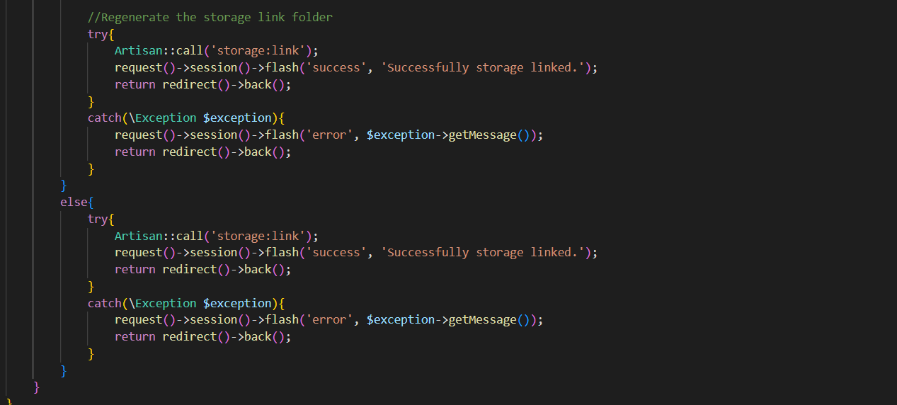
7. Try And Catch Block

Slide 61
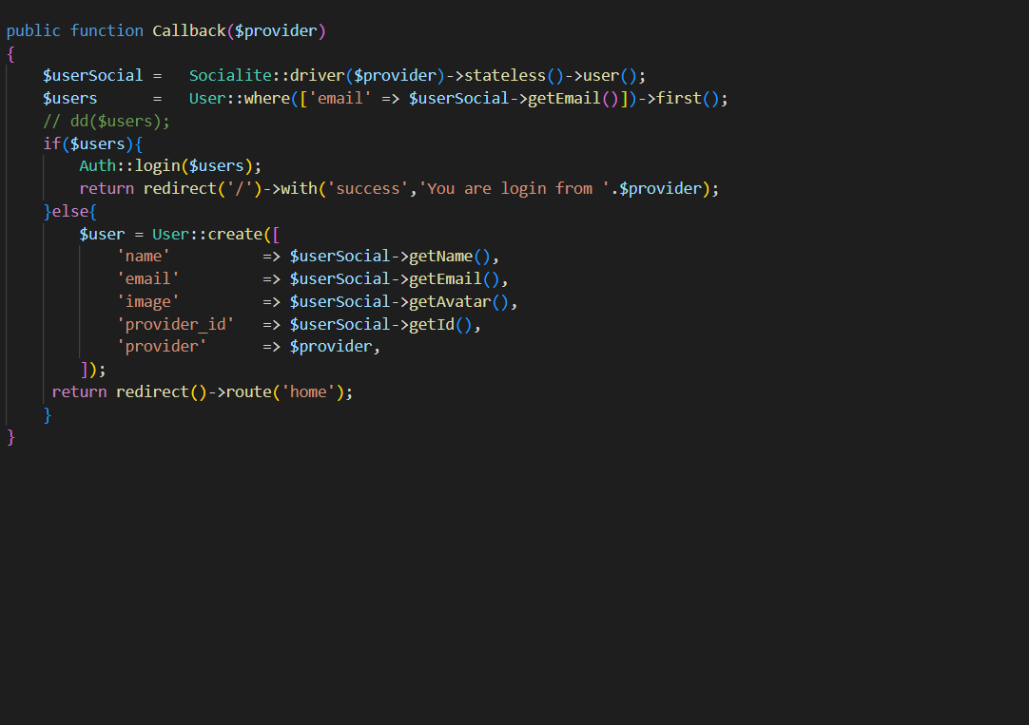
Validation

Slide 62
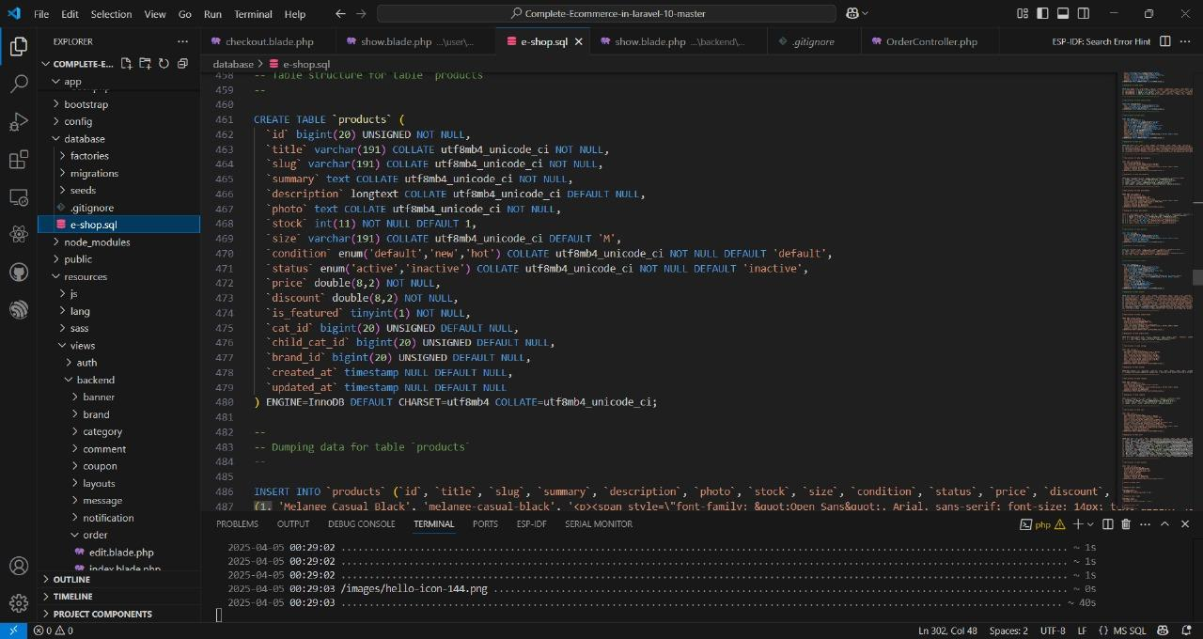
Database degine

Slide 63
4.2
SCREENSHOTS

Slide 64
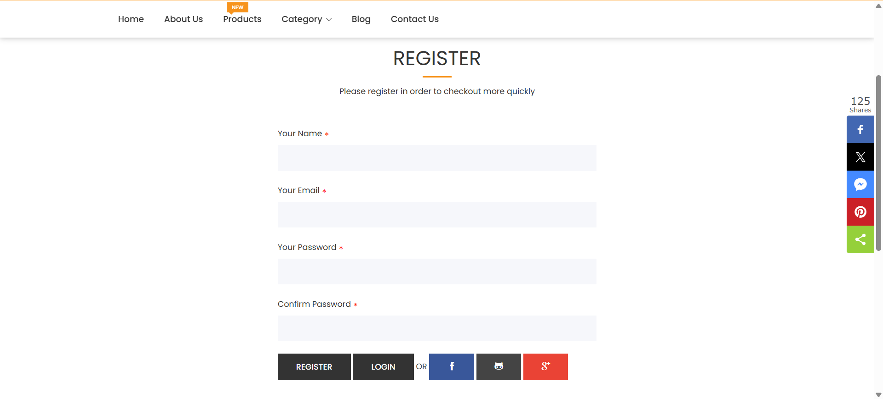
Registration page

Slide 65
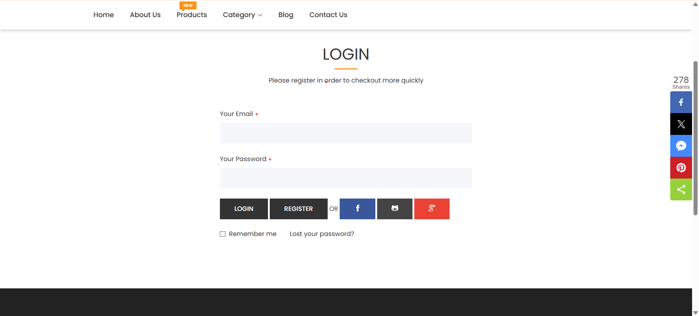
Login page

Slide 66
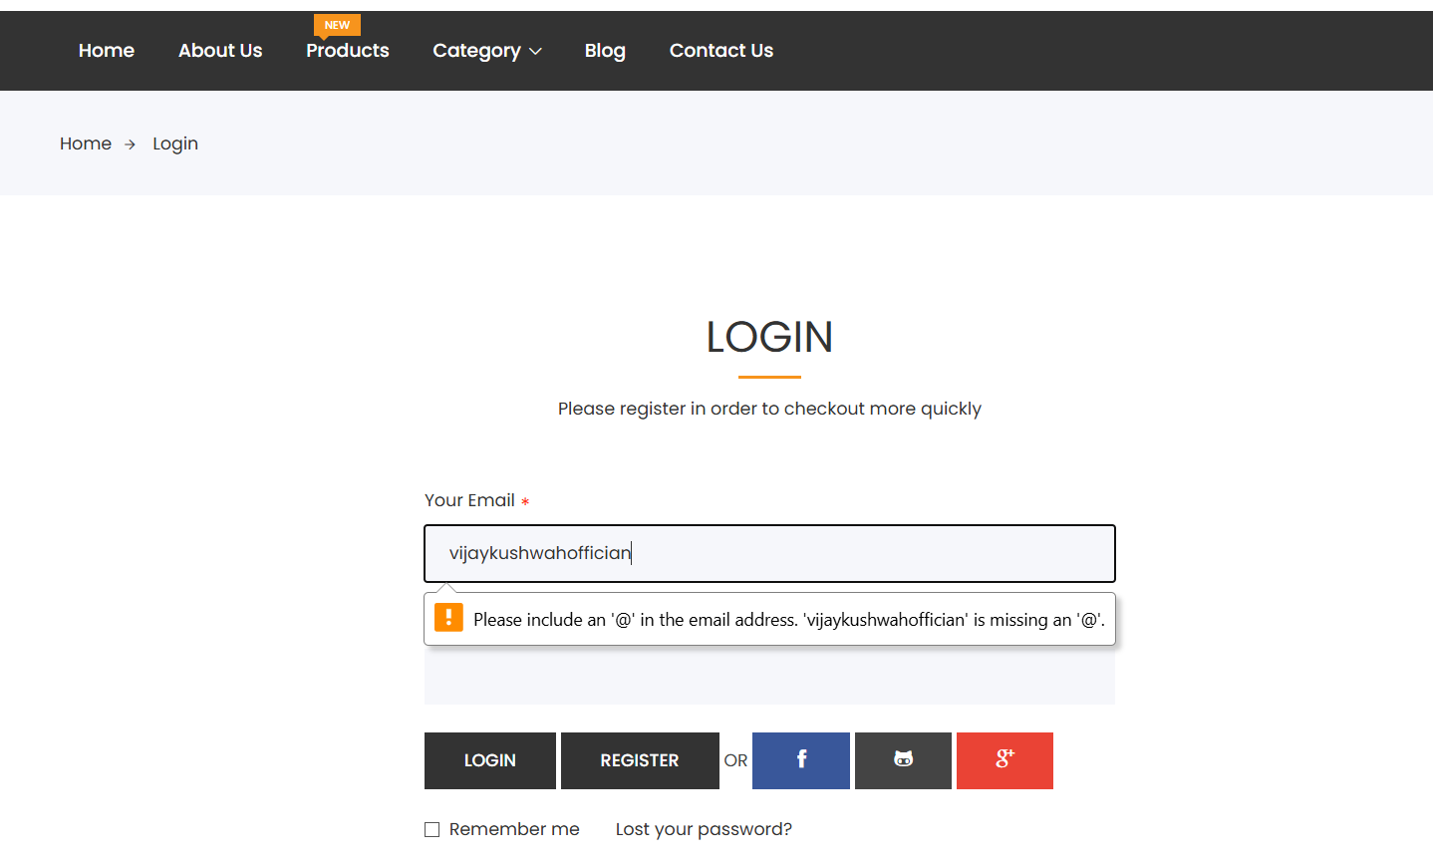
Login Authentication

Slide 67
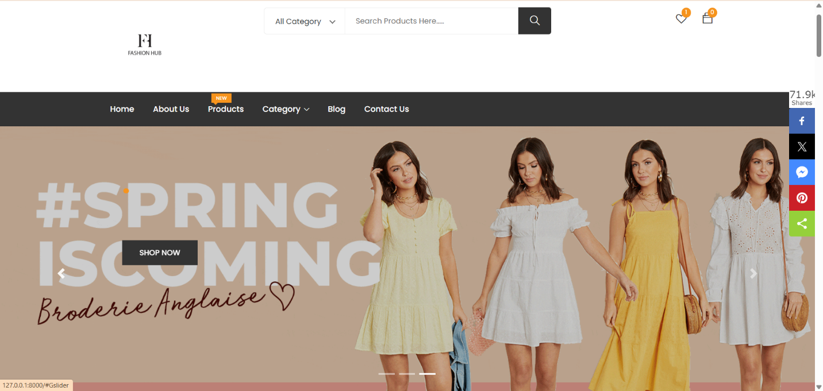
Home Page

Slide 68
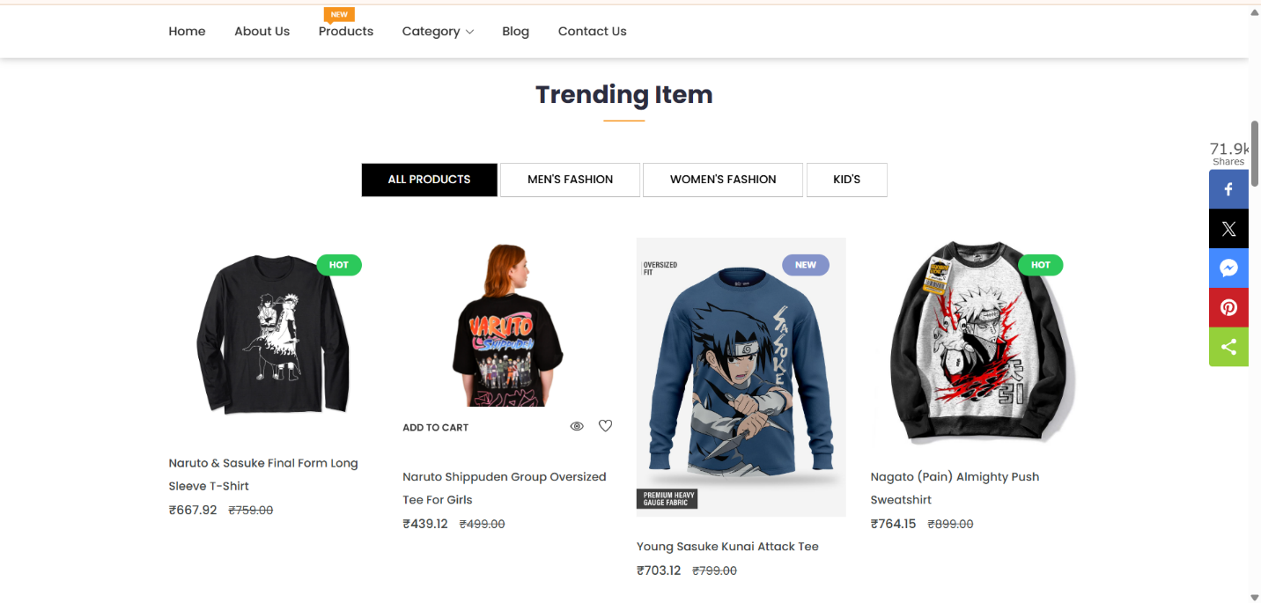
Trending items

Slide 69
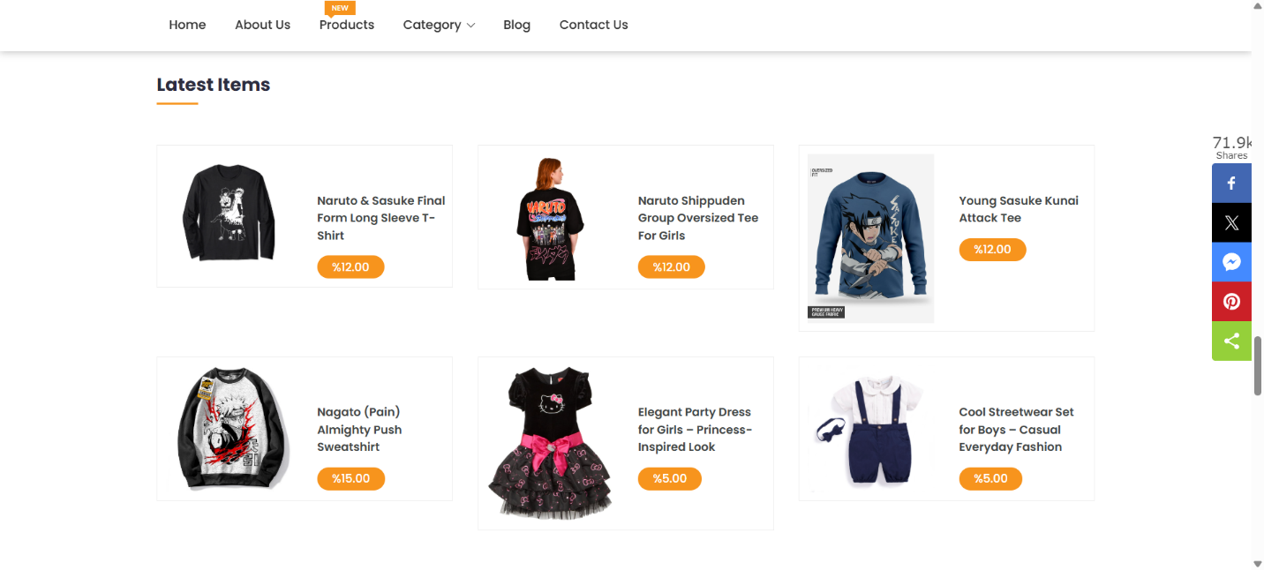
Latest items

Slide 70
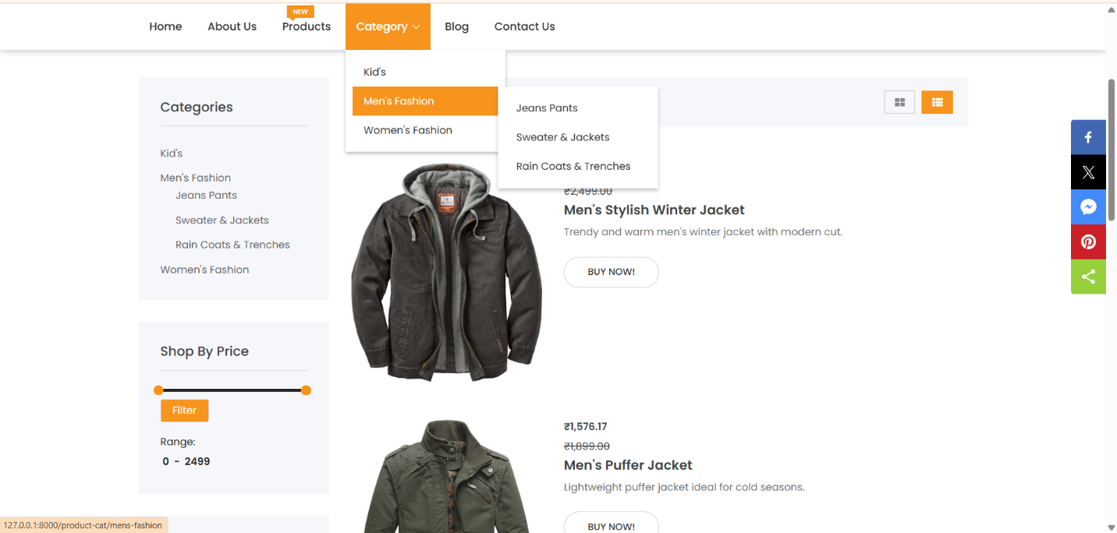
Category page

Slide 71
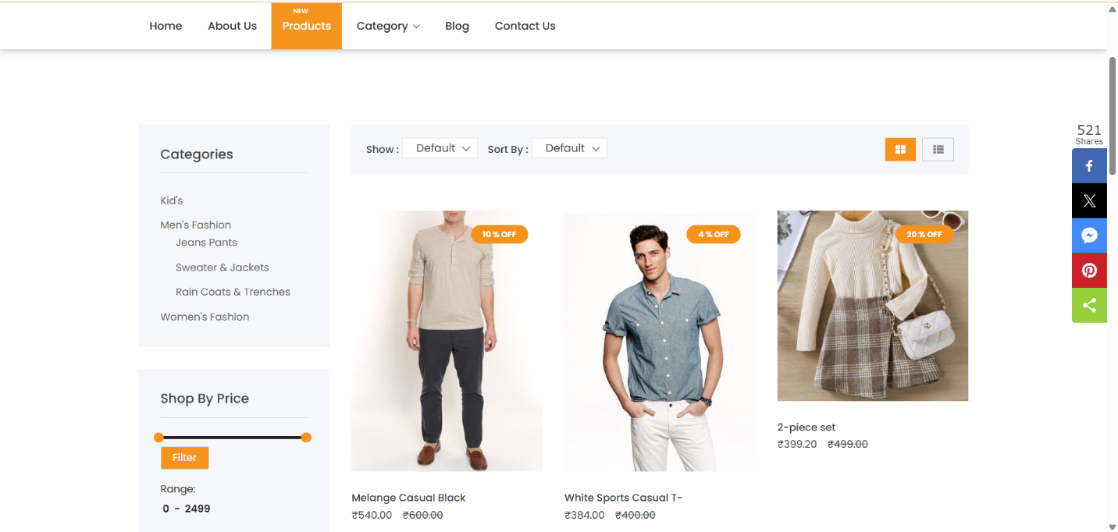
Product page

Slide 72
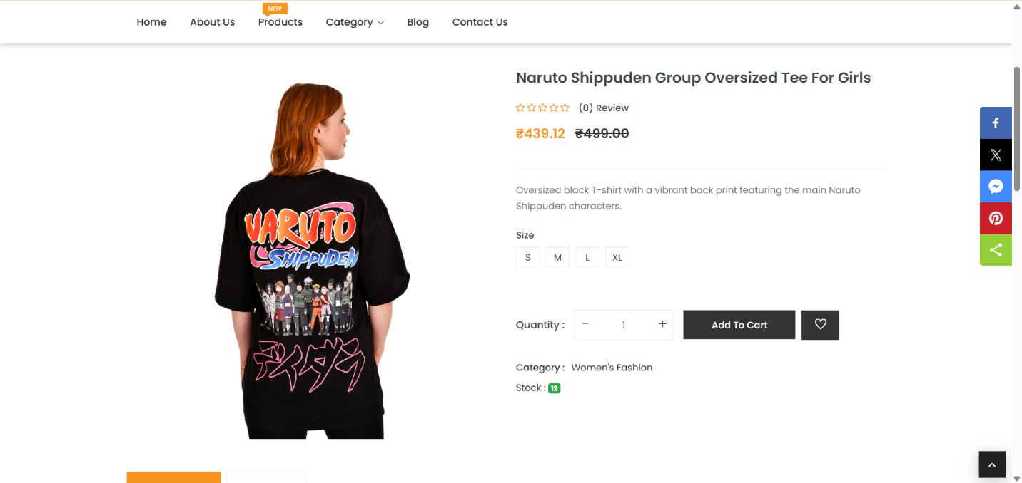
Product Details Page

Slide 73
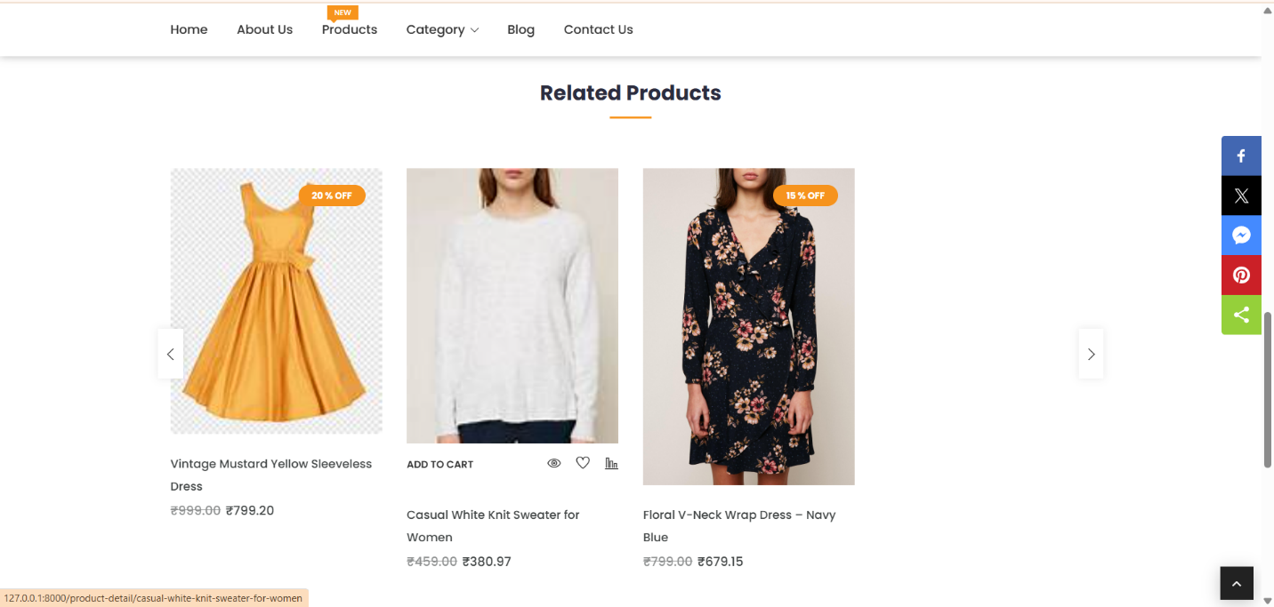
Related Product

Slide 74
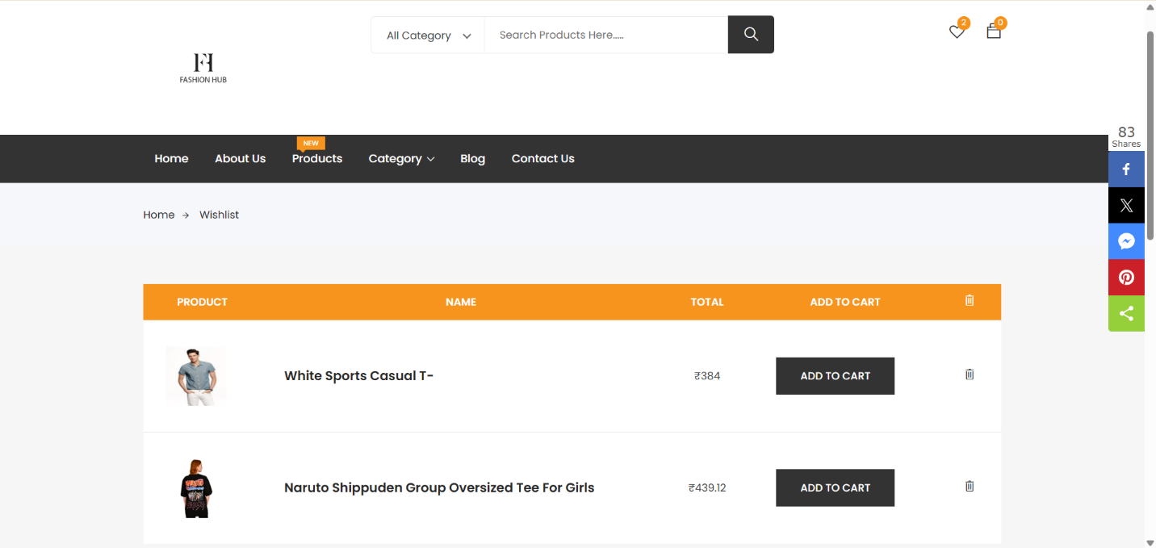
Wishlist Page

Slide 75
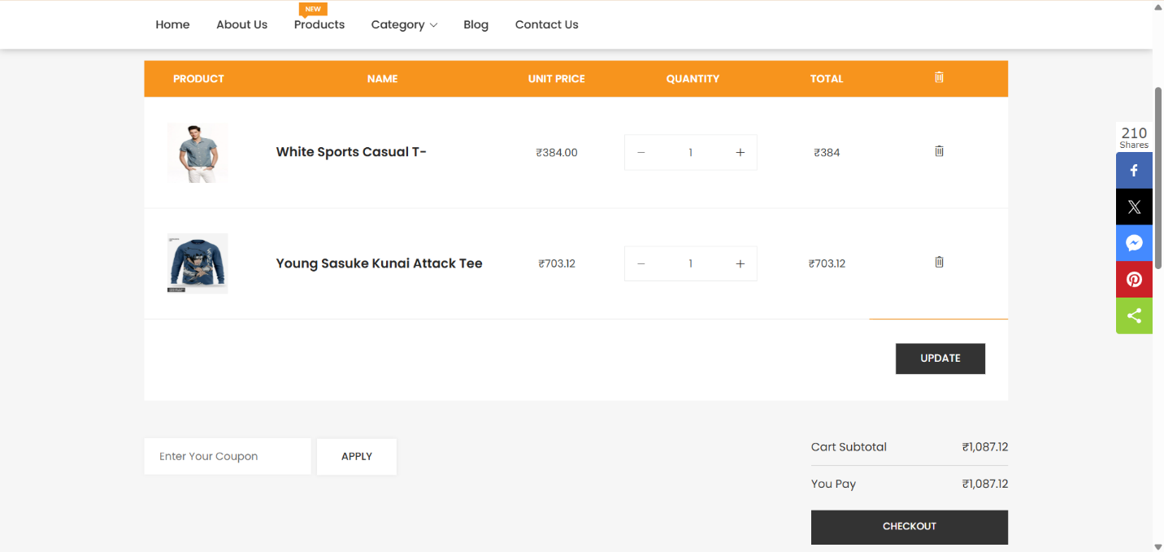
Cart Page

Slide 76
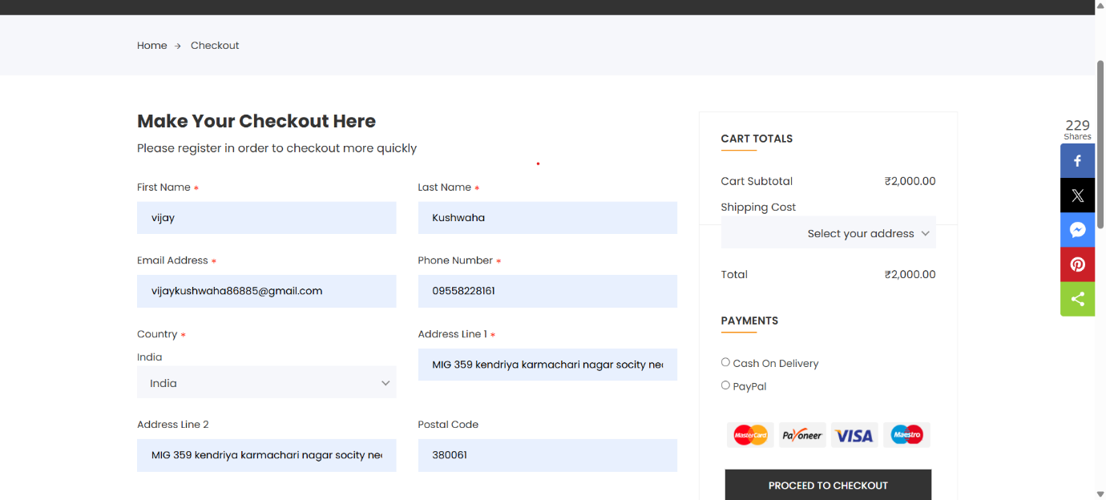
Checkout Page

Slide 77
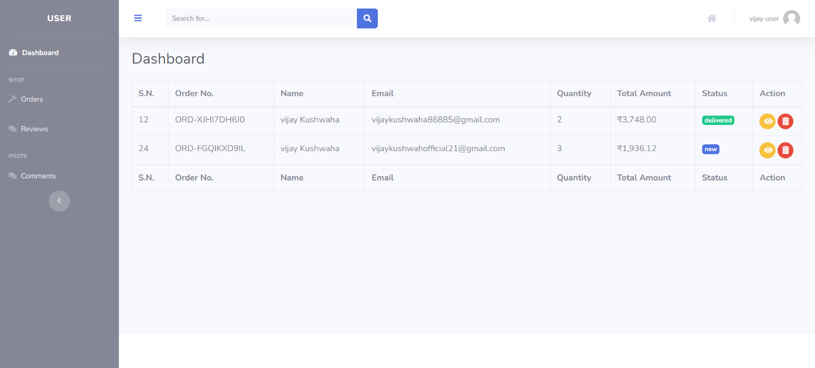
User Dashboard page

Slide 78
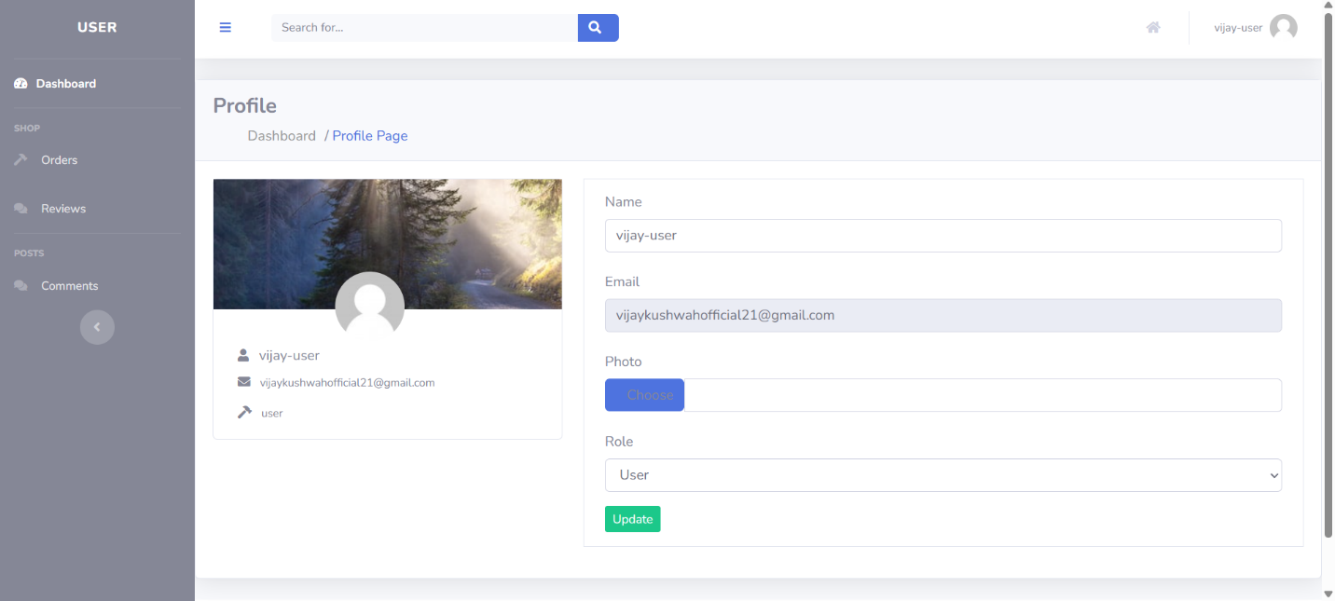
User profile page

Slide 79
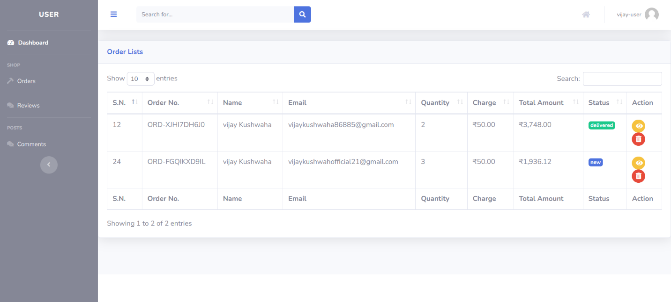
Order page

Slide 80
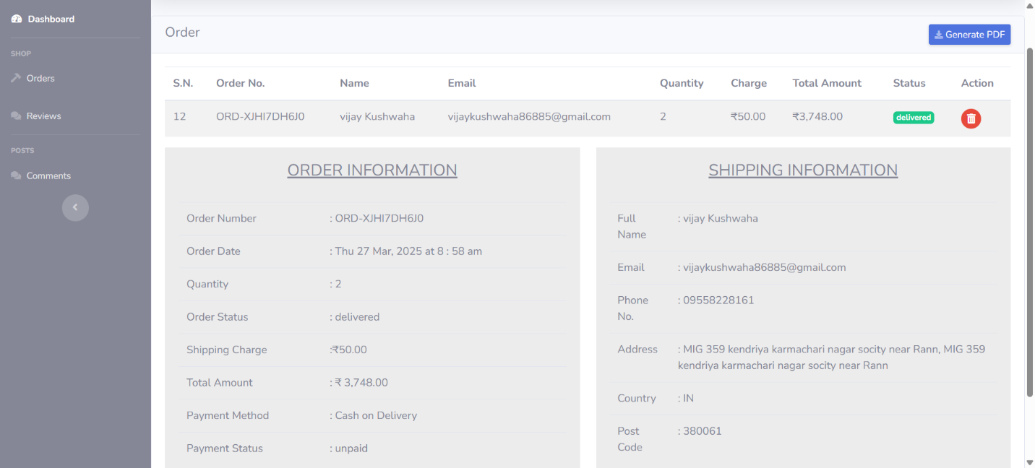
Order Details Page

Slide 81
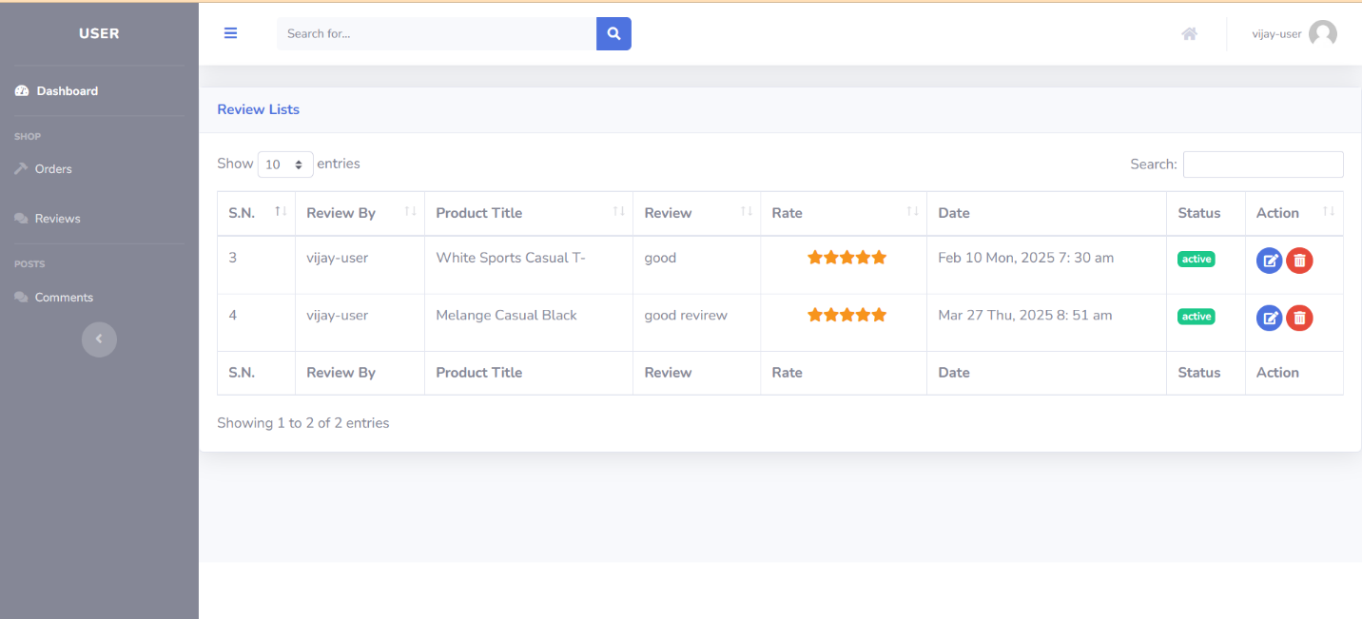
Review page

Slide 82
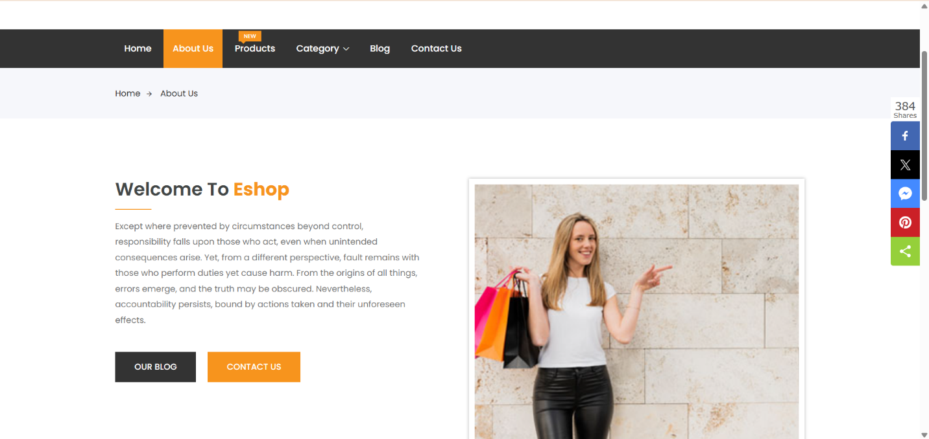
About us page

Slide 83
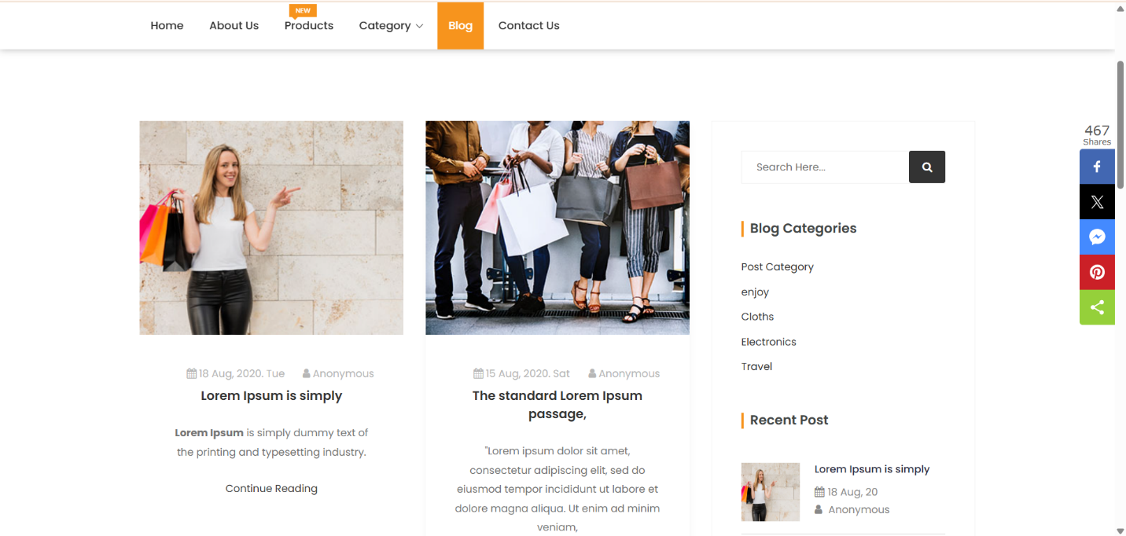
Blog page

Slide 84
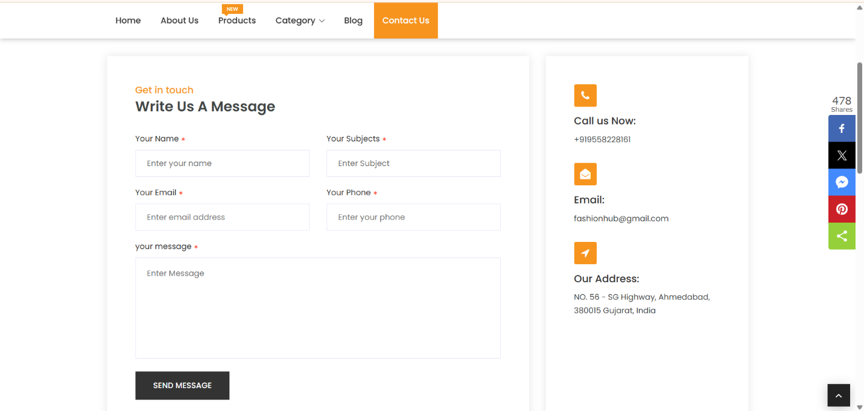
Contact-us page

Slide 85
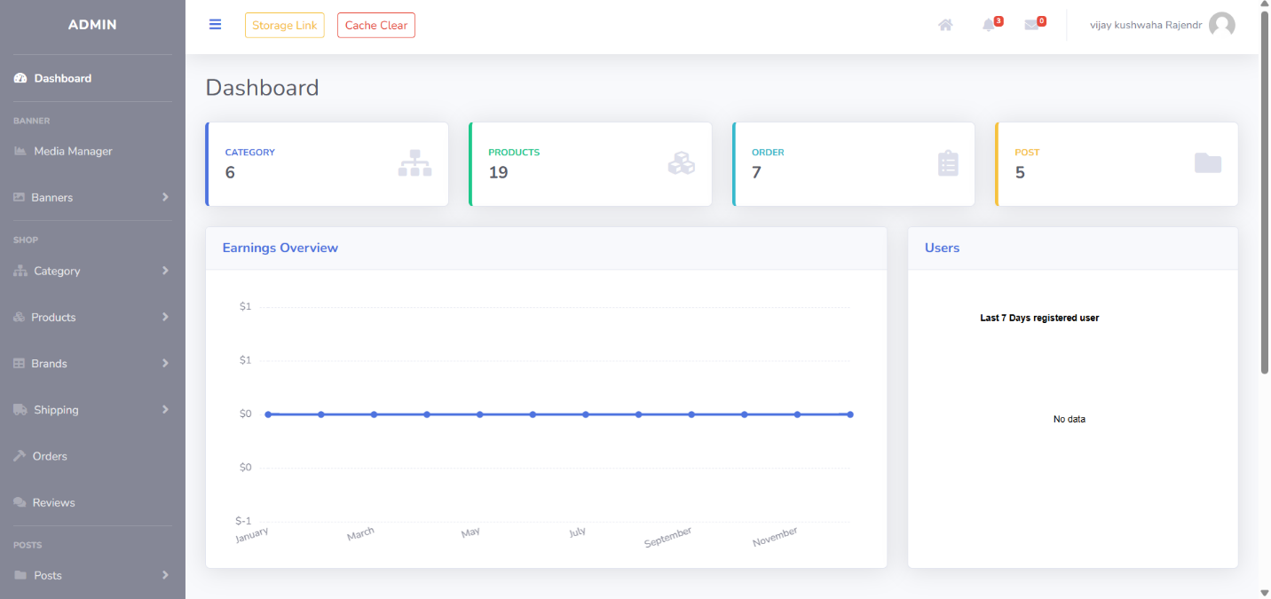
Admin side
Admin Dashboard page

Slide 86
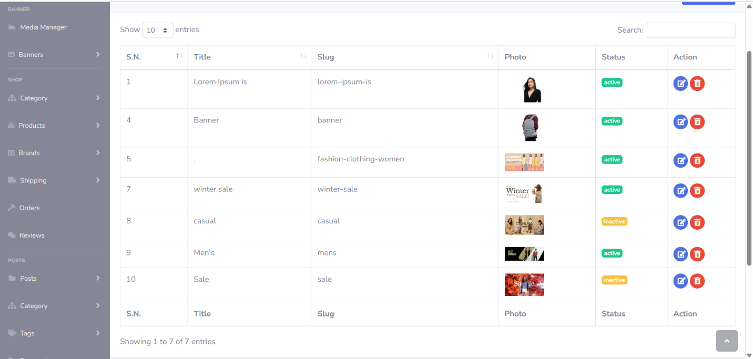
Banner page

Slide 87
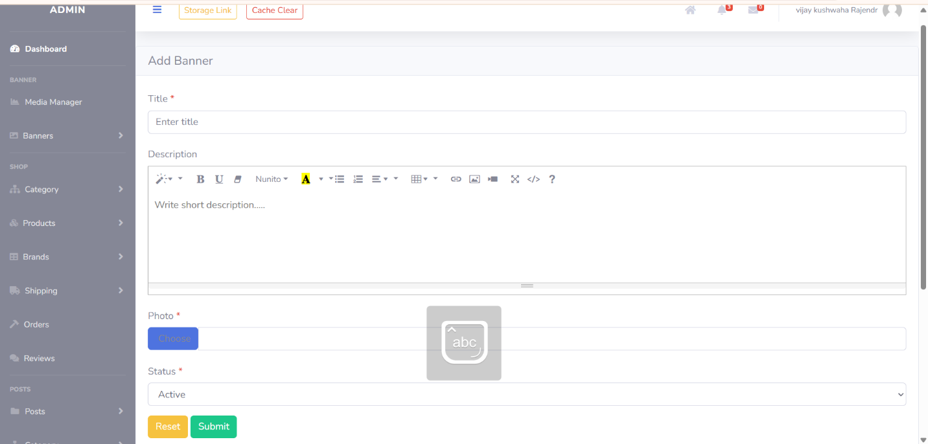
Add Banner Page

Slide 88
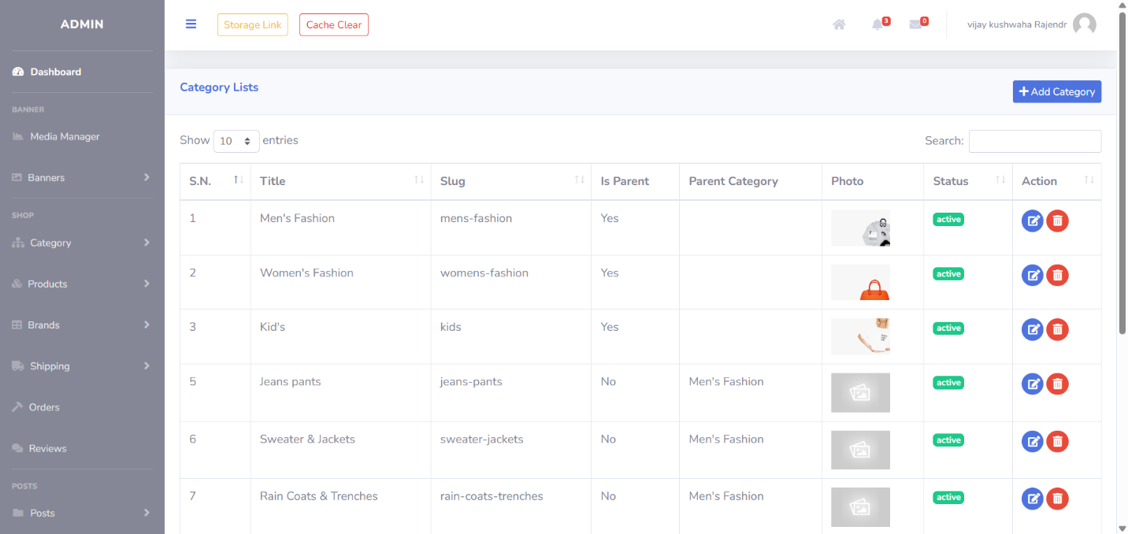
Category Page

Slide 89
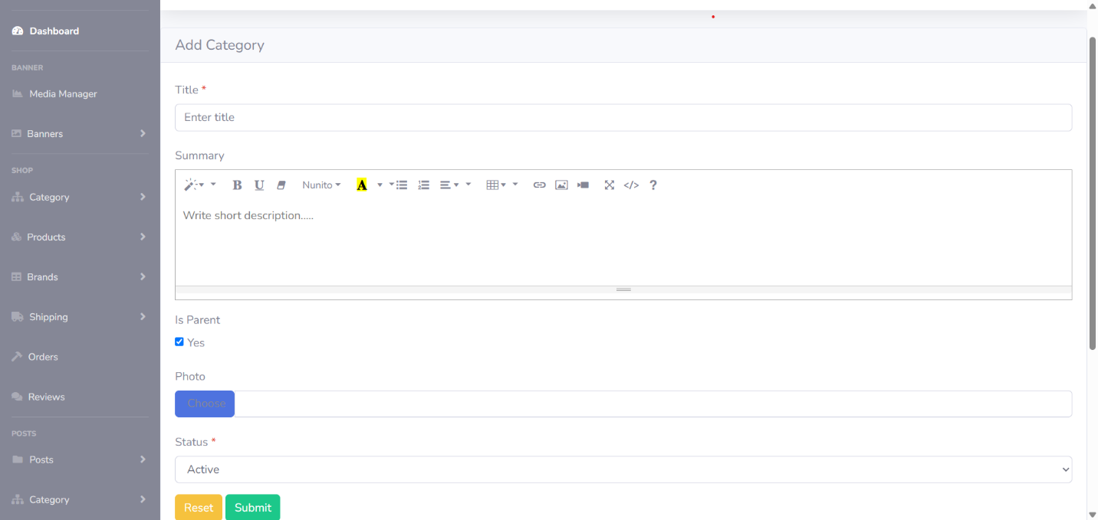
Add Category Page

Slide 90
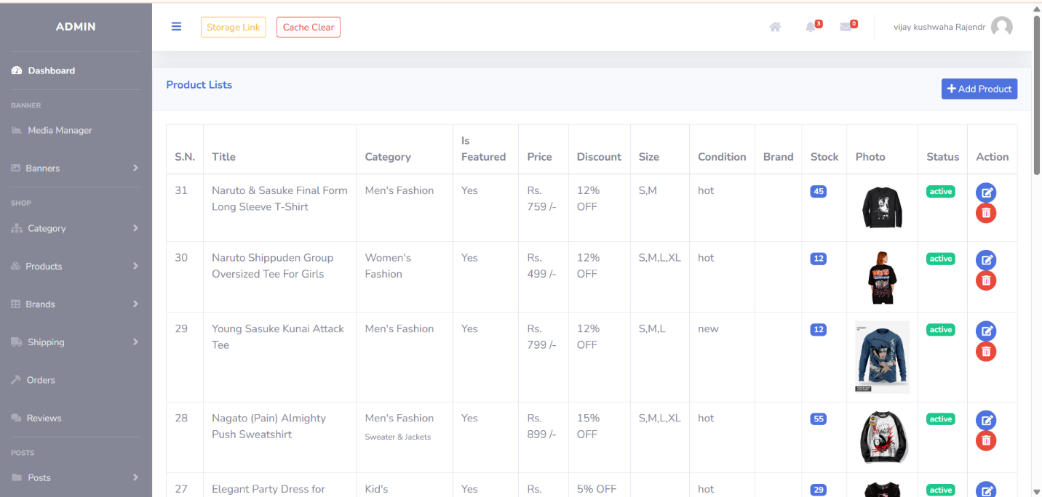
Product Page

Slide 91
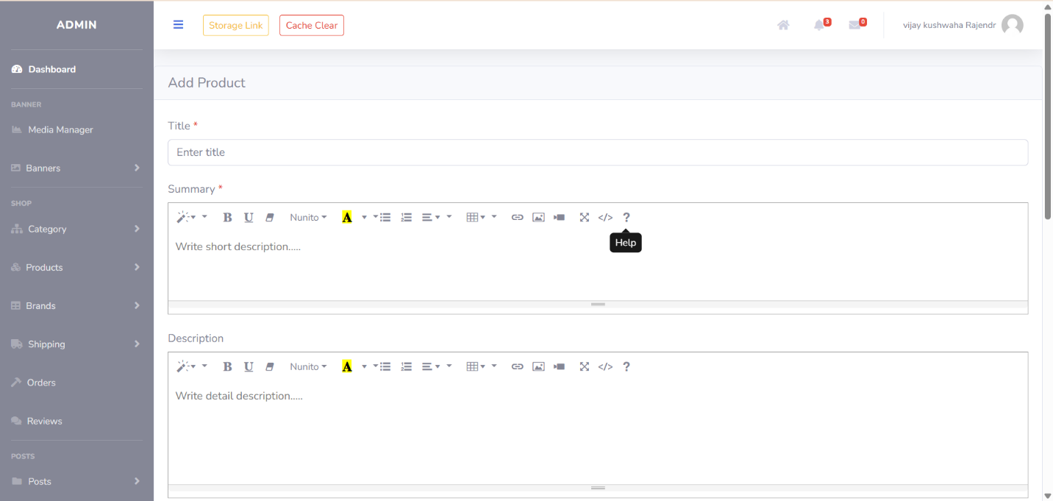
Add Product Page

Slide 92
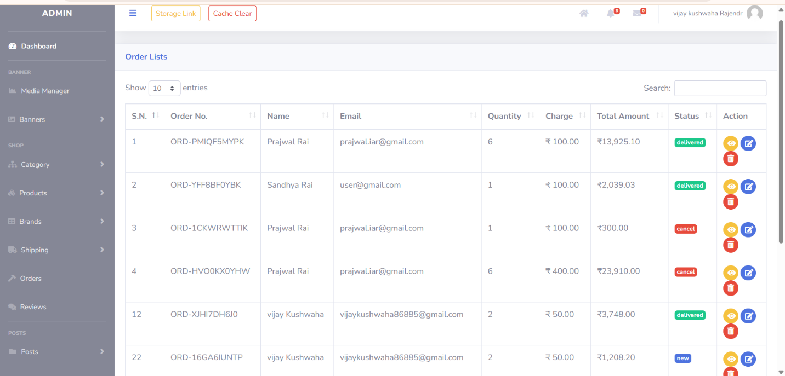
Order Page

Slide 93
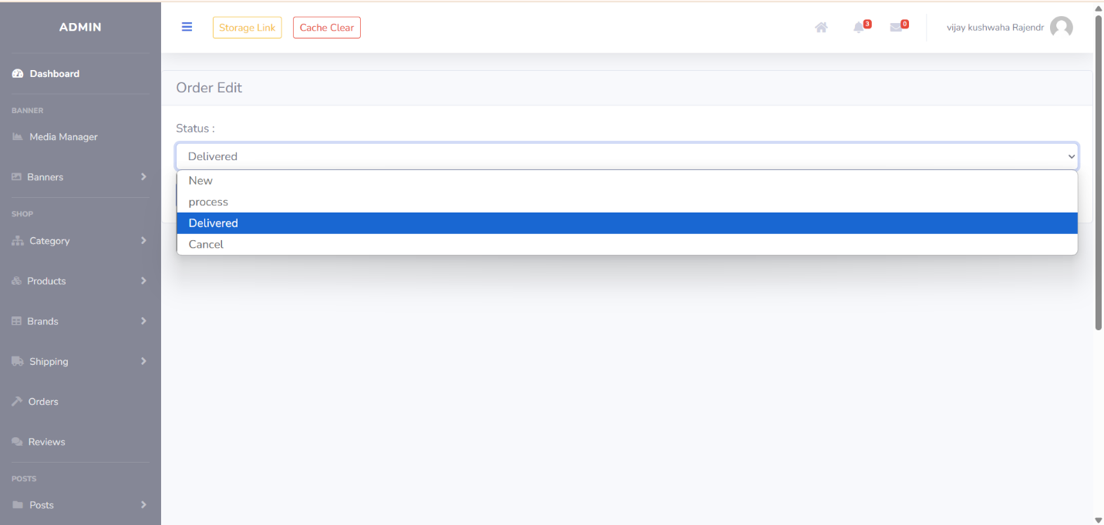
Change Order Status Page

Slide 94
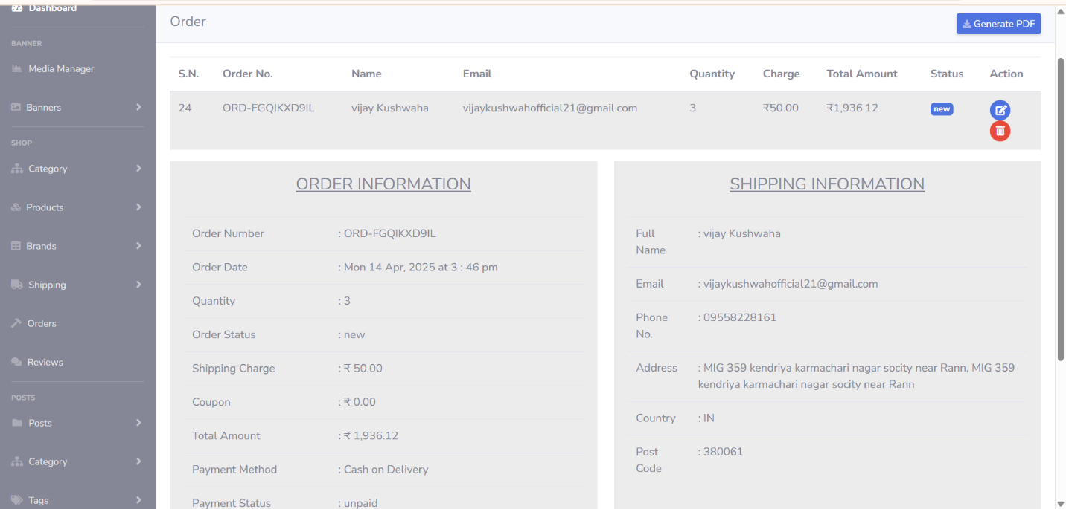
Order Details Page

Slide 95
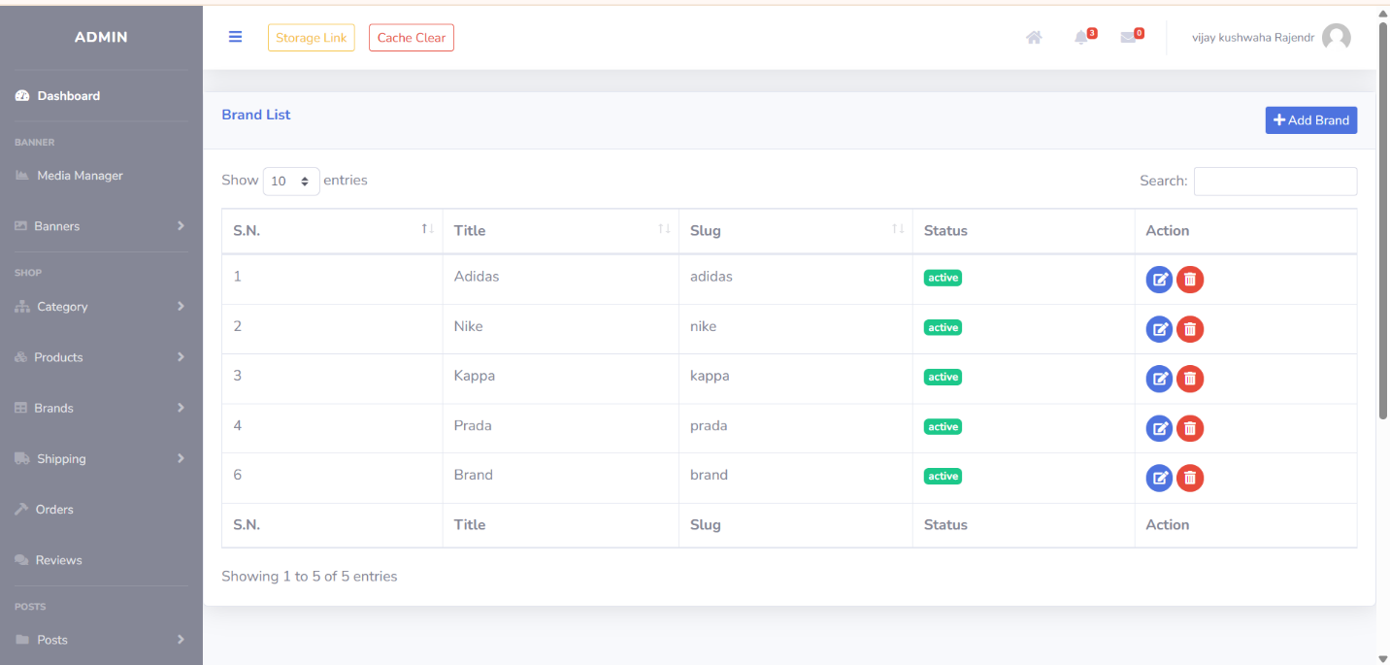
Brand Page

Slide 96
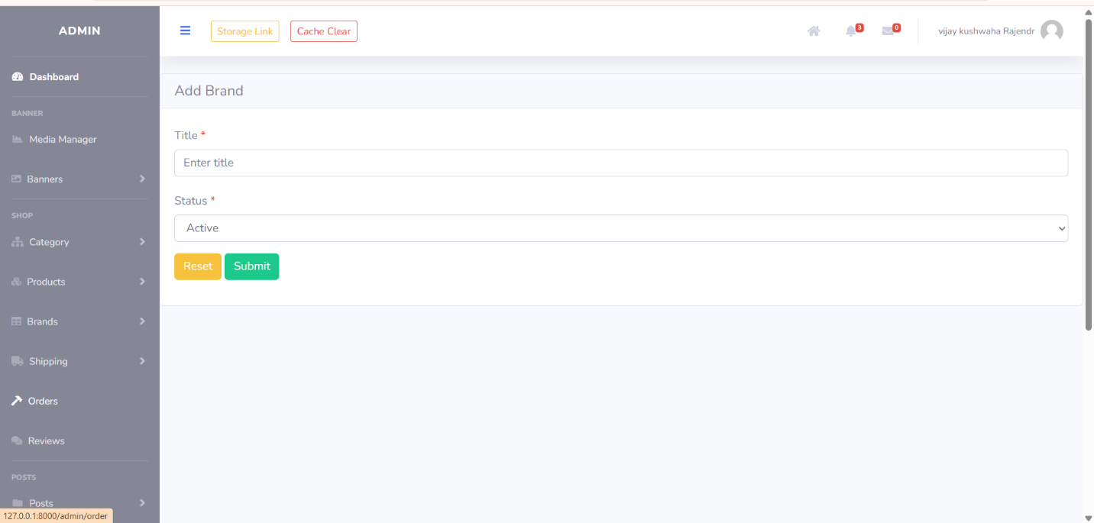
Add Brand Page

Slide 97
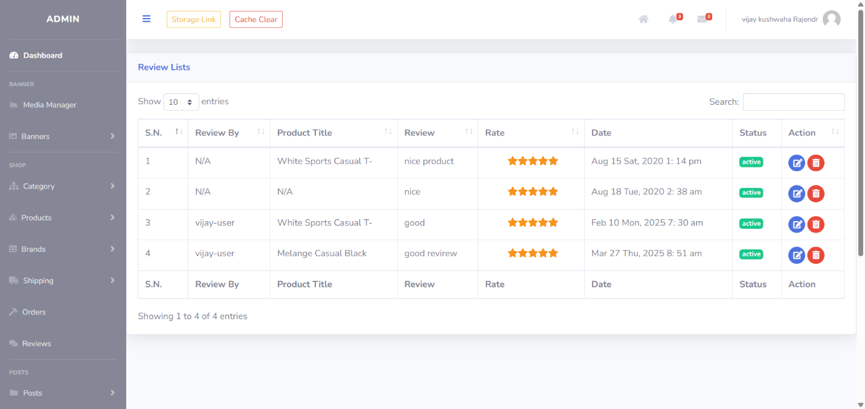
Review Page

Slide 98
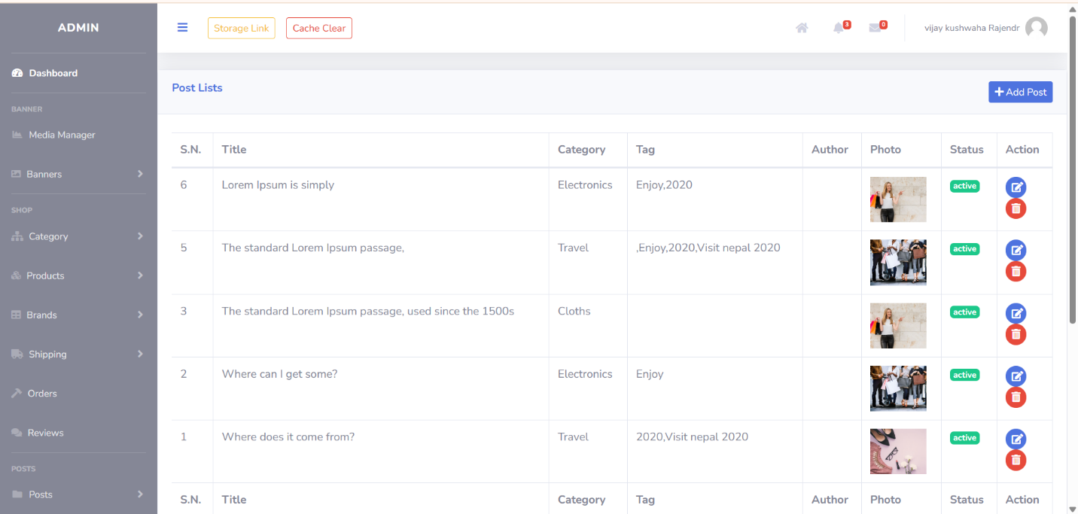
Post page

Slide 99
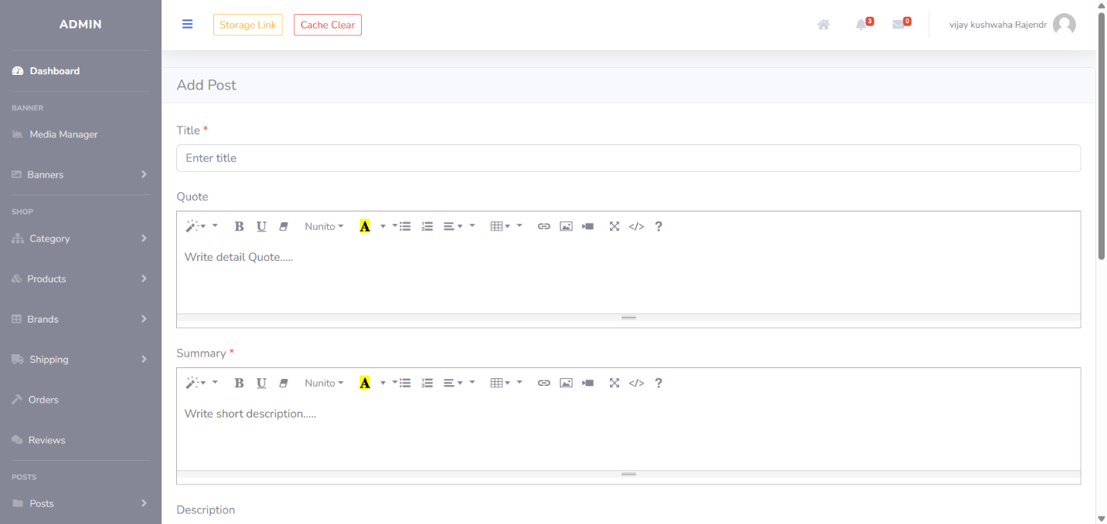
Add Post Page

Slide 100
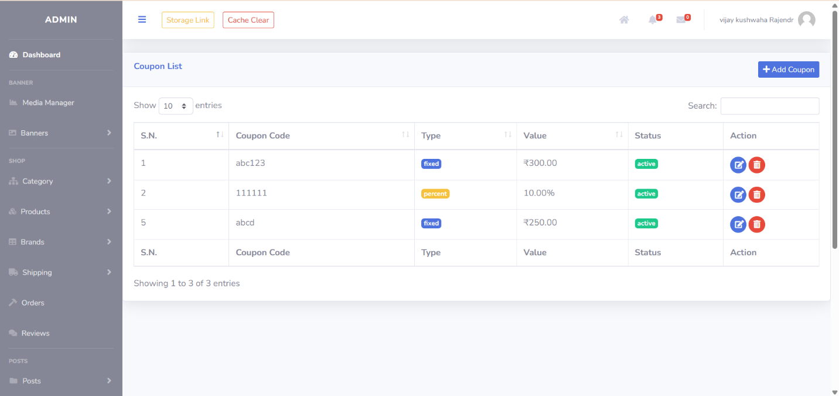
Coupon Page

Slide 101
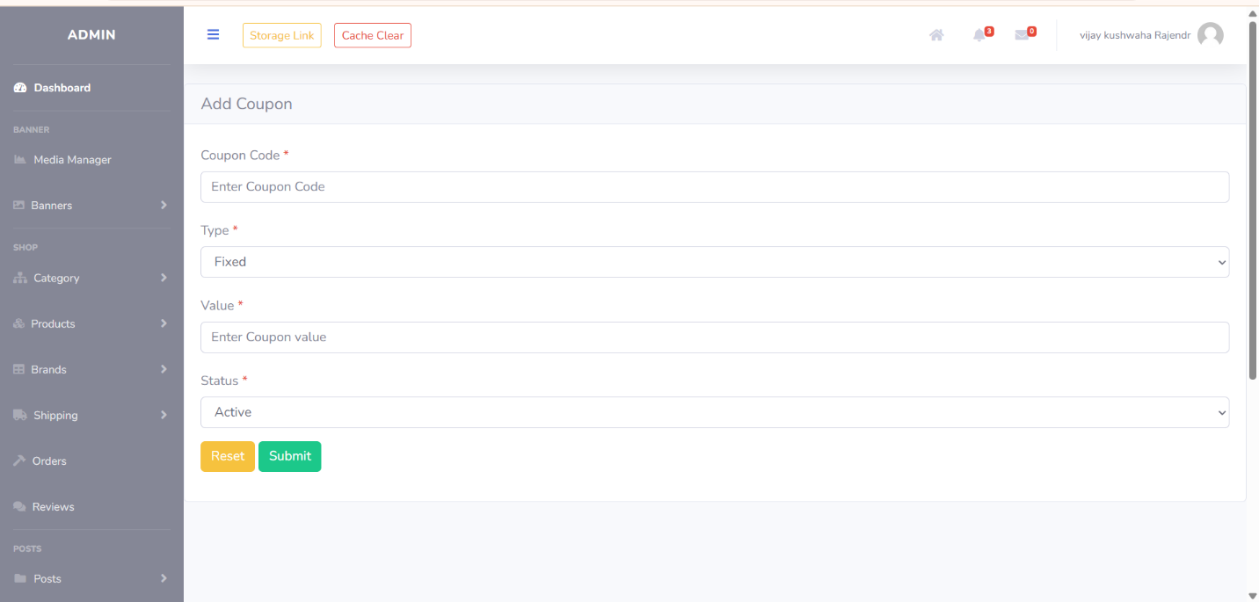
Add Coupon Page

Slide 102
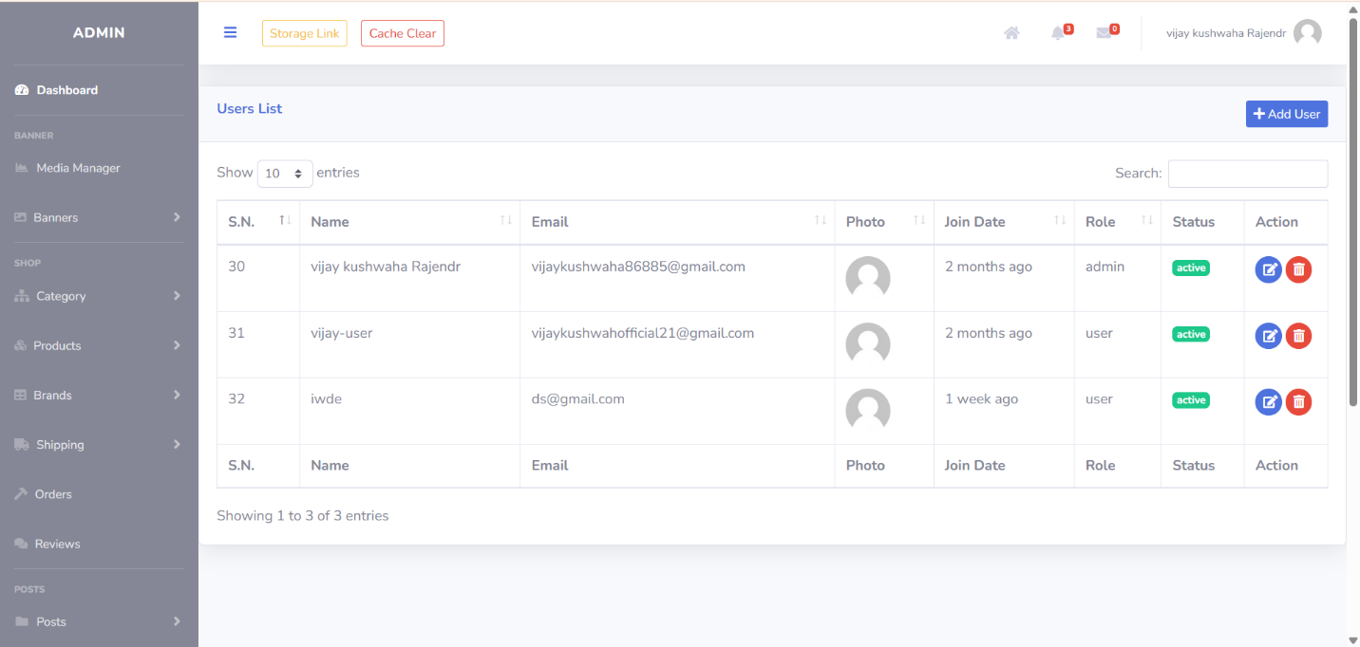
User Detail Page

Slide 103
5
Agile Document

Slide 104
5.1
Agile Project Charter

Slide 105
Agile Project Charter
Project Name: | Fashion Hub
Project Champions: | Varma Shivam, Kushwaha Vijay
Project Sponsor: | L.J MCA DEPARTMENT
Project Managers: | Prof. Krunal Panchal
Expected Start Date: | 06 -Jan-2025
Expected End Date: | 15-Apr-2025
Project Goal: | To build an easy-to-use Fashion Hub Website that makes online shopping simple, efficient, and enjoyable. The website will allow users to browse and buy clothing, manage their accounts, and track their orders, while also handling inventory, process payments, and analyse sales trends.
Project Vision: | Devinder is a platform that helps developers connect based on their skills, interests, and project needs. It aims to simplify collaboration and networking by enabling users to find suitable partners for open-source projects, startups, or mentorship.
Project Scope: | Shopping & Product Management: Allow customers to browse clothing collections with filters like size, colour, and price. Let's easily add, edit, and manage products. Seamless Ordering & Checkout : Enable users to add items to their cart and securely complete purchases. Provide multiple payment options, including credit/debit cards and COD. Smart Automation & Trending Items : shipping updates, and stock Inventory and Trending items on Dashboard
Key Stakeholder | Project Managers, Team Members/Developers, Clients/End Users.
Risk | API Integration Failure The system may fail to integrate smoothly with third- party service like payment gateways. Version Compatibility Issues: Updates to system components (databases, APIs, frameworks) may break compatibility.

Slide 106
5.2
Agile Roadmap / Schedule

Slide 107
Agile Roadmap / Schedule
Phase | Month | Duration | Theme/Epic | Feature
Phase1: Foundation | January | Week 1 | Development Environment Setup | Set up development, testing, and staging environments. Configure version control and install Laravel with MySQL database.
 |  | Week 2 | Core System Architecture | Implement user authentication, dashboard setup, and basic navigation structure.
 |  | Week 3-4 | Product Management (MVC) | Develop product listing, categories, and inventory management features.
Phase2:Core Functionality | February | Week 1 | User Roles & Permissions | Implement role-based access for admins, sellers, and customers.
 |  | Week 2 | Shopping Cart & Wishlist | Enable users to add/remove products, save items, and manage their cart.
 |  | Week 3 | Secure Payment System | Integrate payment gateways (Stripe) and ensure secure transactions.
 |  | Week 4 | Order Management & Tracking | Implement order processing, tracking, and status updates.
Phase3 :Development | March | Week 1 | UI/UX Design & Testing | Finalize front-end design, optimize for mobile, and conduct usability testing.
 |  | Week 2 | Admin Dashboard | Build an admin panel to manage products, users, and orders efficiently.
 |  | Week 3 | Customer Reviews & Ratings | Enable users to leave product reviews and ratings.
 |  | Week 4 | Deployment Preparation | Set up deployment pipeline, optimize performance, and conduct final code reviews.
Phase3 Deployment & Maintenance | April | Week 1 | Deployment & Feedback Collection | Launch a website, monitor performance, and collect user feedback.
 |  | Week 2 | Maintenance & Bug Fixing | Fix bugs, optimize performance, and plan future updates.

Slide 108
5.3
Agile Project Plan

Slide 109
AT RISK | TASK NAME | RESPONSIBLE | STORY POINTS | START DATE | END DATE | DURATION (in days) | STATUS | COMMENTS
No | SPRINT 1 |  |  | 6-Jan-25 | 1-Feb-25 | 28
NO | Development environment setup | Shivam | 3 | 6-Jan-25 | 10-Jan-25 | 5 | Completed | Set up dev, testing, and staging environments
No | Basic website structure & navigation | Shivam | 5 | 10-Jan-25 | 17-Jan-25 | 8 | Completed | Homepage, navigation menus
No | Product and category(MVC) | Vijay | 13 | 18-Jan-25 | 1-Feb-25 | 15 | Completed | Product display with categories & search
No | SPRINT 2 |  |  | 2-Feb-25 | 29-Feb-25 | 27
No | Shopping cart & Wishlist | Shivam | 5 | 2-Feb-25 | 9-Feb-25 | 8 | Completed | Add to cart, save items, remove products
No | Role-based access control | Vijay | 8 | 10-Feb-25 | 20-Feb-25 | 8 | Completed | Admin, Manager, Team member roles
No | Secure checkout & payment integration | Vijay | 5 | 21-Feb-25 | 29-Feb-25 | 15 | Completed | Stripe integration
No | SPRINT 3 |  |  | 1-Mar-2025 | 23-Mar-2025 | 23
No | Order management & tracking | Vijay | 8 | 1-Mar-2025 | 10-Mar-2025 | 10 | Completed | tracking, order status updates
No | Reporting & analytics module | Vijay | 8 | 11-Mar-2025 | 23-Mar-2025 | 13 | Completed | Sales reports, user activity tracking
Yes | SPRINT 4 |  |  | 24-Mar-2025 | 15-Apr-25 | 23
No | Final deployment | Shivam | 3 | 24-Mar-2025 | 28-Mar-2025 | 5 | Completed | Deploy to production server
Yes | Post-deployment bug fixes | Vijay | 15 | 29-Mar-2025 | 15-Apr-25 | 18 | In Progress | Final testing & user feedback incorporation

Slide 110
5.4
Agile User Story

Slide 111
Agile User Story
User Story ID | Priority | As a | I want to | So that I can
1 | High | Customer | Register and log in | Access my account and track my orders
2 | High | Customer | Browse products by category | Easily find the clothing I need
3 | High | Customer | View product details (price, size, reviews) | Make an informed purchasing decision
4 | High | Customer | Add items to my cart | Save my selections before checkout
5 | High | Customer | Apply filters (size, color, brand, price) | Find relevant products quickly
6 | High | Customer | Purchase products securely | Complete my order safely
7 | High | Customer | Track my order status | Know when my order will arrive
8 | High | Customer | Save items to a wishlist | Keep track of things I want to buy later
9 | High | Customer | Leave product reviews | Share my experience with others
10 | Medium | Customer | Contact customer support | Get help if I have any issues
11 | High | Admin | Manage product listings (add, update, delete) | Keep the catalog up to date
12 | High | Admin | Track orders and shipments | Ensure smooth order full filment
13 | High | Admin | Approve or reject product reviews | Maintain quality control on reviews
14 | High | Admin | Manage discount campaigns | Offer promotions to attract more customers
15 | High | Admin | View sales reports and analytics | Track performance and make data-driven decisions

Slide 112
Agile User Story
User Story ID | Priority | As a | I want to | So that I can
16 | Medium | Admin | Manage registered users | Monitor and control customer access
17 | High | System | Send order confirmation and tracking updates | Keep customers informed about their purchases
18 | High | System | Generate sales reports | Help the admin analyze performance
19 | Medium | System | Recommend products based on user behavior | Improve customer experience and increase sales
20 | Medium | System | Send low-stock alerts to the admin | Ensure popular items are restocked
21 | High | Seller | Register and manage my store | List my products for customers to buy
22 | Medium | Seller | Manage stock levels | Keep my inventory updated
23 | Low | Customer | View size guides and fit recommendations | Ensure I order the right size
24 | Low | Customer | See fashion trends and styling tips | Get inspiration for my outfits
25 | Medium | System | Notify customers about restocked items | Encourage repeat purchases

Slide 113
5.5
Agile Release Plan

Slide 115
5.6
Agile Sprint Backlog

Slide 117
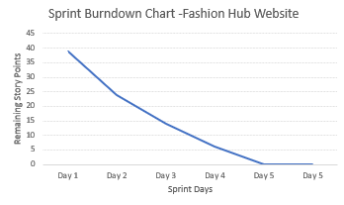
2) Sprint Burndown Chart:

Slide 118
5.7
Agile Test Plan

Slide 120
5.8
Earned-value and burn charts

Slide 122


Slide 123
24. Proposed Enhancement

Slide 124
1.Admin Dashboard Enhancements
Sales & Performance Reports: Provide real-time analytics on sales, customer behaviour, and product performance.
User Management Tools: Easily manage customer accounts, order histories, and refund requests.
AI-Based Demand Forecasting: Use machine learning algorithms to predict fashion trends and stock demand.
2.Faster Database Performance
Description: Optimized data processing for quicker load times
Benefits:
Faster order processing.
Smooth handling of high traffic.
Reduced server load and downtime.

Slide 125
3.AI-Powered Recommendation Engine
Description: Use machine learning to suggest products based on browsing history, purchase history, and popular trends.
Benefit: Personalized shopping experience leading to increased sales.
4. Multilingual and Multi-Currency Support
Description: Allow users to browse the website in different languages and currencies.
Benefit: Prepares the platform for international expansion

Slide 126
25. Conclusion

Slide 127
25) Conclusion:
The Fashion Hub clothing website was created to provide a seamless, secure, and engaging online shopping experience for both customers and local fashion retailers. Built using powerful backend technologies like Laravel and MySQL, and a responsive Bootstrap-based frontend, the platform offers strong performance with easy navigation. With Stripe integrated for payment processing, it ensures secure and reliable online transactions.
By following the Agile development methodology, the project was completed in small, manageable steps that allowed for continuous feedback and improvements. This approach helped us efficiently build essential features such as user account management, product browsing, a shopping cart, and secure checkout, all tailored to create a smooth and satisfying user experience

Slide 128
26. Bibliography

Slide 129
This bibliography covers Laravel (PHP), MySQL, and Stripe payment gateway integration, along with frontend development, Agile project tracking tools, and real-world fashion website references. These sources were essential in creating a secure, scalable, and user-friendly Fashion Hub website.
1. Websites & Online Articles
1. Laravel Official Documentation
Usage: Referenced for routing, middleware,
authentication, and API development.
URL: https://laravel.com/docs
2. PHP Manual – Official PHP Documentation
Usage: Used for backend scripting, session handling, and security best practices.
URL: https://www.php.net/manual/en/
3. MySQL Documentation – Oracle
Usage: Used for database structuring, queries, indexing, and performance optimization.
URL: https://dev.mysql.com/doc/
4. Stripe Documentation – Payment Gateway
Usage: Used for secure online payments and checkout integration.
URL: https://stripe.com/docs
5. Agile Alliance Resources
Usage: Used to understand Agile principles, Scrum methodology, sprint planning, and team collaboration.
URL: https://www.agilealliance.org/agile101

Slide 130
2. Tools & Libraries Documentation
1.Laravel Framework – PHP MVC Framework
Usage: Used for building the backend of the clothing website.
URL: https://laravel.com/
2. MySQL – Database Management System
Usage: Used for user data, product listings, orders, and transactions.
URL: https://www.mysql.com/
3.Bootstrap – Frontend CSS Framework
Usage: Used for creating responsive UI components.
URL: https://getbootstrap.com/
4.Stripe API – Payment Processing
Usage: Integrated for handling online transactions securely.
URL: https://stripe.com/docs/api

Slide 131
3. Fashion Brand References
The following clothing and fashion websites were studied for design inspiration, product presentation, user experience, and overall functionality:
Vero Moda – https://www.veromoda.in
KALKI Fashion – https://www.kalkifashion.com
Fabindia – https://www.fabindia.com
Snitch – https://www.snitch.co.in
Raymond – https://www.raymond.in

